Slide 1
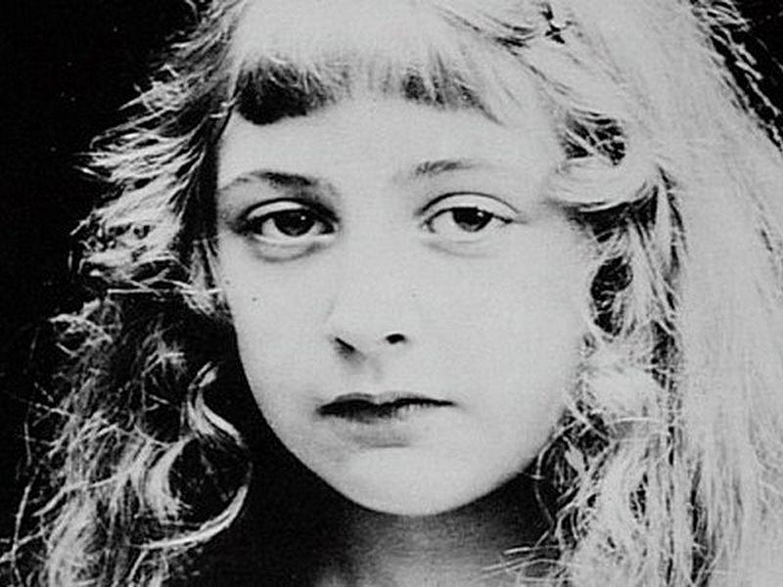
Agatha Christie
Agatha Christie is a famous detective story writer. She was born in 1890 in Devon in the south west of England. She never went to school but was educated at home. When she was eleven her father died.

Slide 2
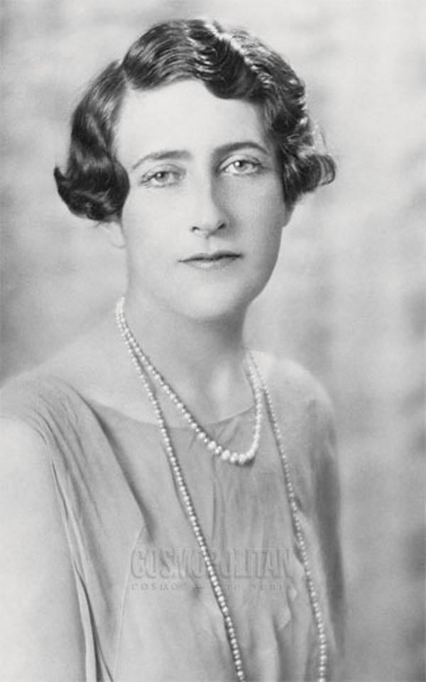
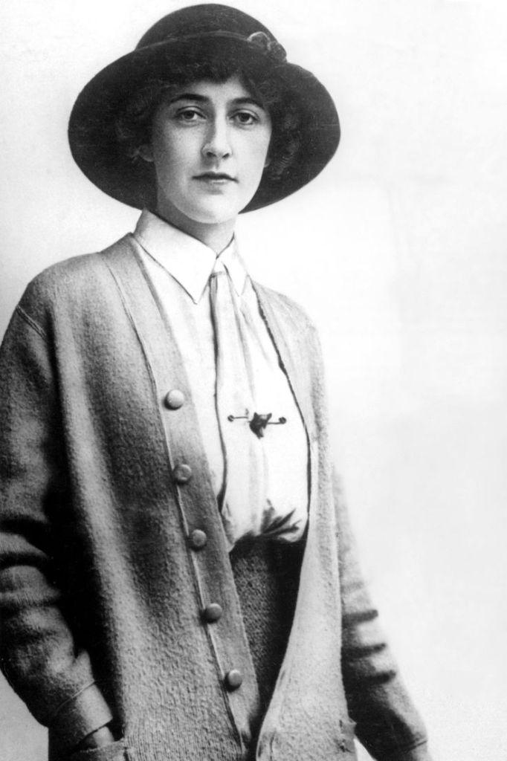
She married twice. During the World War 1 she was working in a hospital. She learned a lot about poisons there.

Slide 3
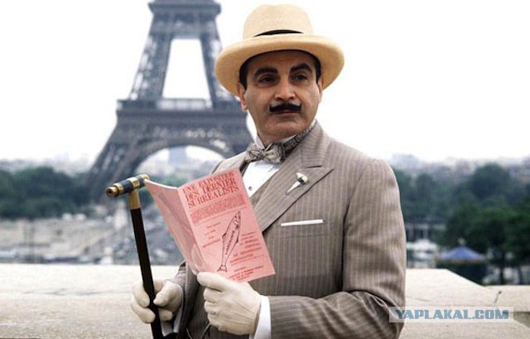
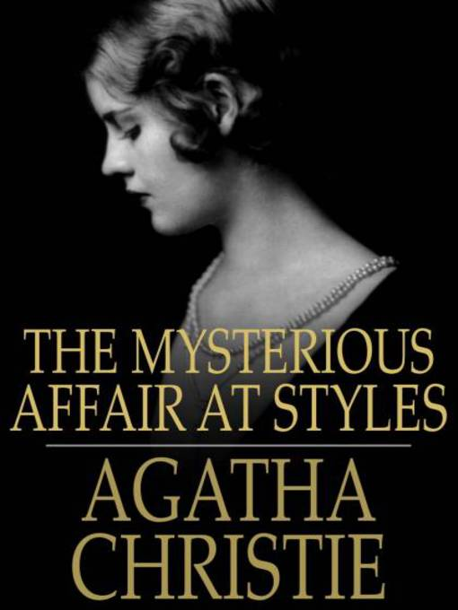
Her most famous character was Hercule Poirot. He was very popular. The first novel with Poirot was The Mysterious Affair at Styles. It was published in 1920.

Slide 4
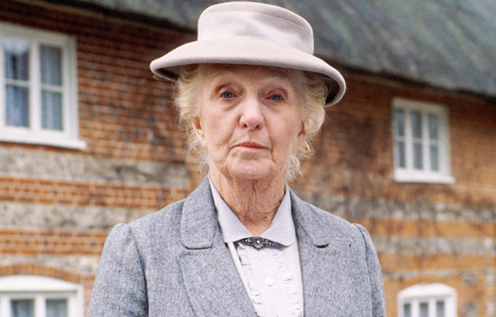
Miss Marple was introduced in short stories The Thirteen Problems. It was published in 1927. It was based on her grandmother.

Slide 5
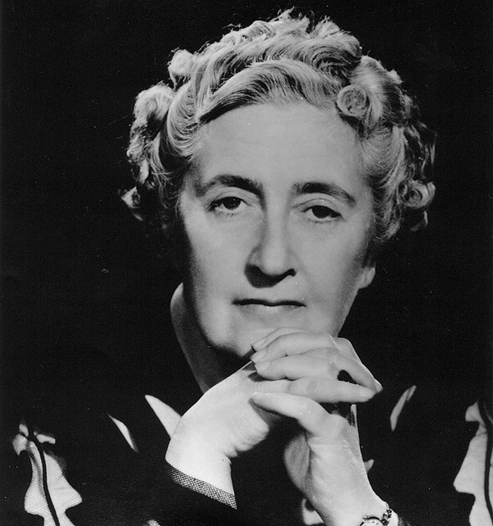
She wrote 79 novels. She was very shy. She led a quiet life. She tried to avoid media. She spent time with her family. She died in 1976. She is considered a master of her genre. She is called the “Queen of Crime”.

