Slide 1
Seasons
Past Simple

Slide 2
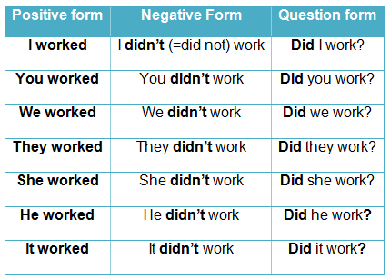

Slide 3
Lets translate! Я допомагав мамі. Аня не готувала торт. Діти ходили до школи? Моя сестра танцювала. Мій кіт не пив молоко. Ти ходив до магазину?

Slide 4
A season – пора року a year – рік a month – місяць winter – зима spring – весна summer – літо autumn - осінь

Slide 5
The four seasons in a year: spring, summer, autumn and winter. Each of them lasts 3 months. Spring comes in March and ends in May. It often rains in spring, especially in April. Summer is the hottest season in the year. It begins in June and ends in August. In summer the sky is clear and cloudless. The days are long and the nights are short and warm. Summer brings fruits and vegetables. It is pleasant to spend this season by the seaside or somewhere in the country. Autumn months are September, October and November. The days are becoming shorter, the sun loses its force. It often rains. It is the season of harvesting. Winter lasts three months as well: December, January and February. It is getting colder day by day. The sun shines rarely and it snows of fen. But everything looks so pretty covered with snow.

Slide 6
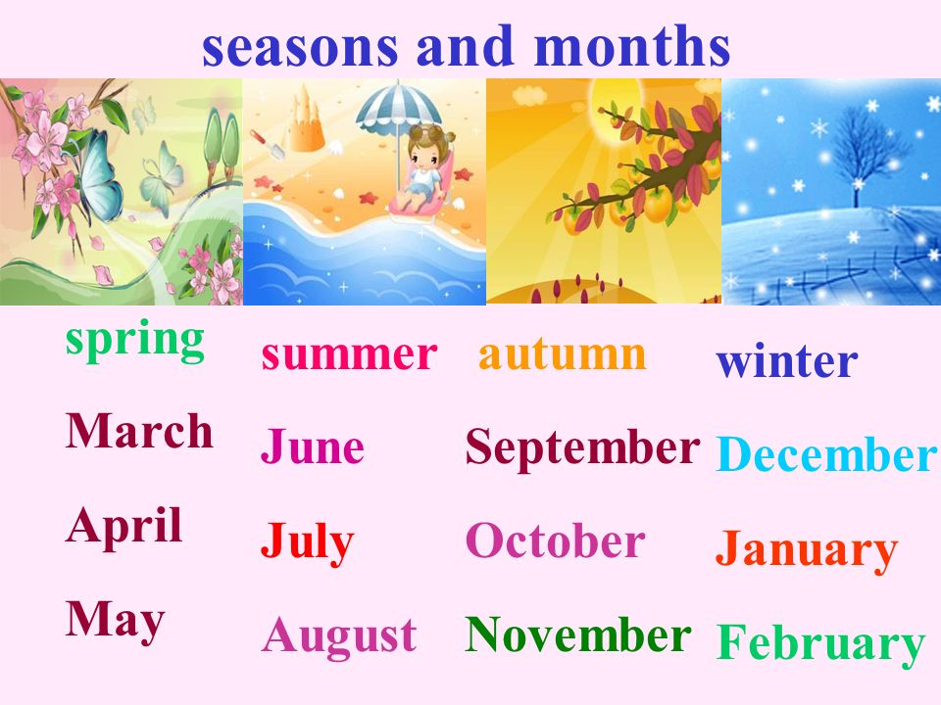

Slide 7
Good Bye!

