Slide 1
Present Continuous
I’d like to…

Slide 2
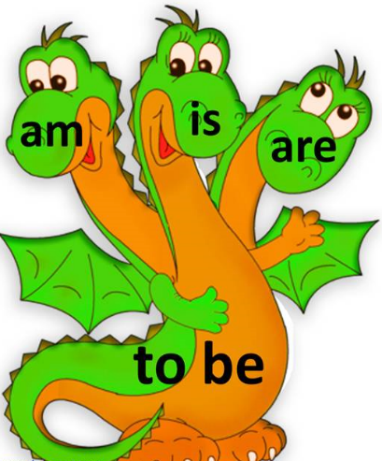

Slide 4
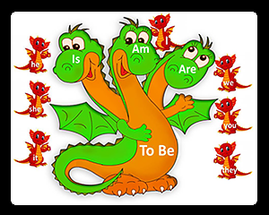
Що я роблю?
Am / is / are + V + ing
I ma reading now. – Я читаю зараз.

Slide 5
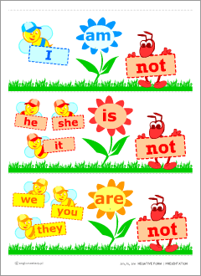
Переклади!
Я готую.
Я сплю.
Аня допомагає.
Діти () грають у футбол.

Slide 6
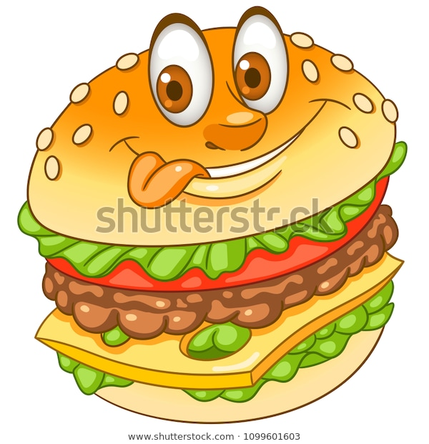
Нова фраза
I’d like to… - Я би хотів…
I’d like to eat a burger. – Я би хотів з'їсти бургер.
I’d like to ride a horse. – Я би хотів проїхати верхи.

Slide 7
Прочитай!
Tom is from Britain. He is a pupil. This is his bag. The bag is green. The pen is orange. The rubber is blue. Tom likes books. He likes to go to school too. He has got a dog and two cats. The dog is grey. The cats are brown. Tom likes to play with his pets. The dog likes to jump, to run and to swim.

