Slide 1
SEASONS AND WEATHER

Slide 2
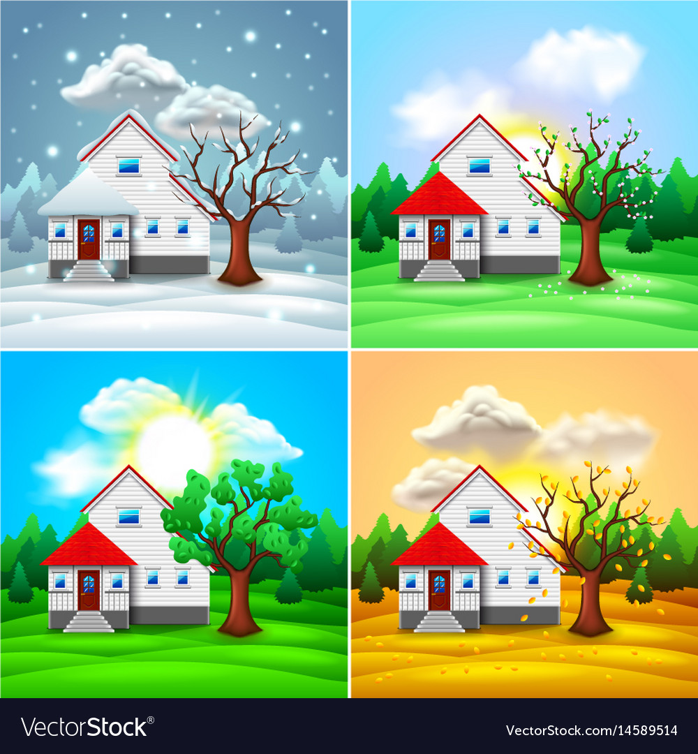
Let’s talk more about four seasons!

Slide 3
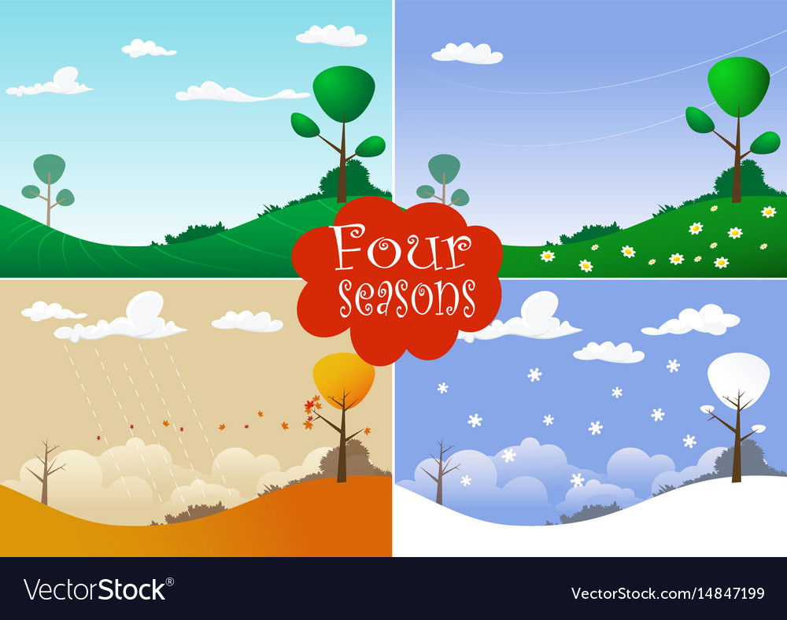
A year has four seasons: spring, summer, autumn and winter.

Slide 4
March, April and May are spring months.

Slide 5
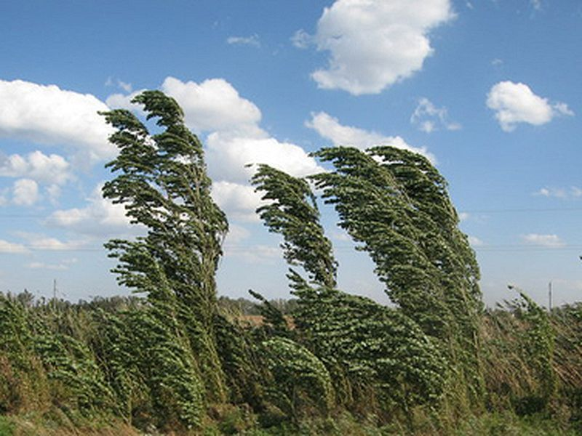
The weather in spring is warm, sunny, and sometimes windy.

Slide 6
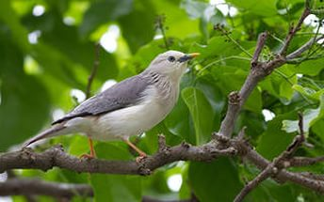
There are green leaves in the trees, birds come back from the South and sing songs.

Slide 7
June, July and August are summer months.

Slide 8
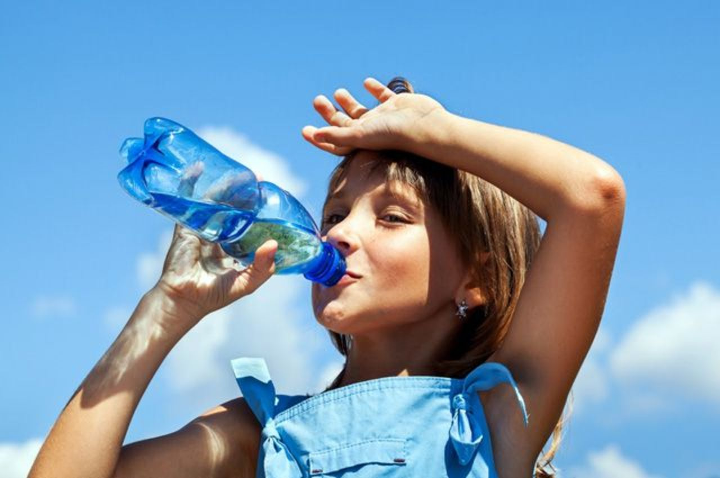
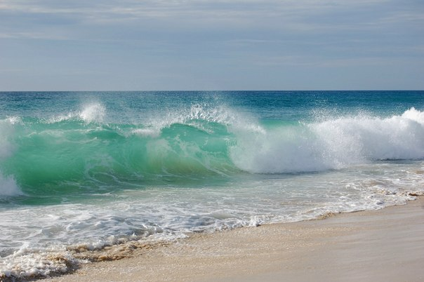
The weather in summer is usually hot, so we can go to the river or to the sea.

Slide 9
We swim, sunbathe and play games.

Slide 10
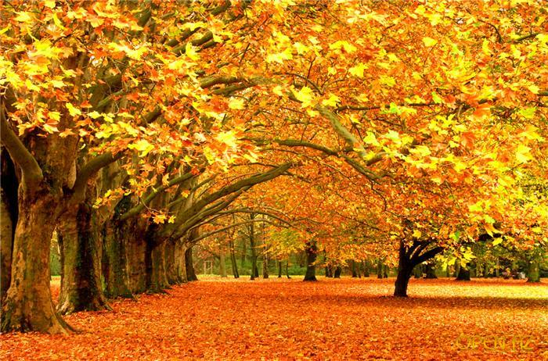
September, October and November are autumn months.

Slide 11
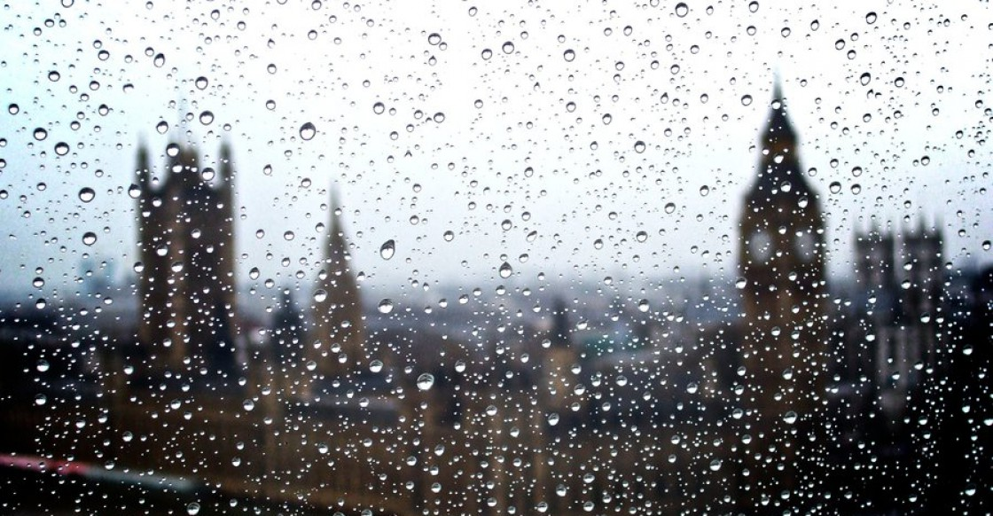
The weather in autumn is cloudy, rainy and windy.

Slide 12
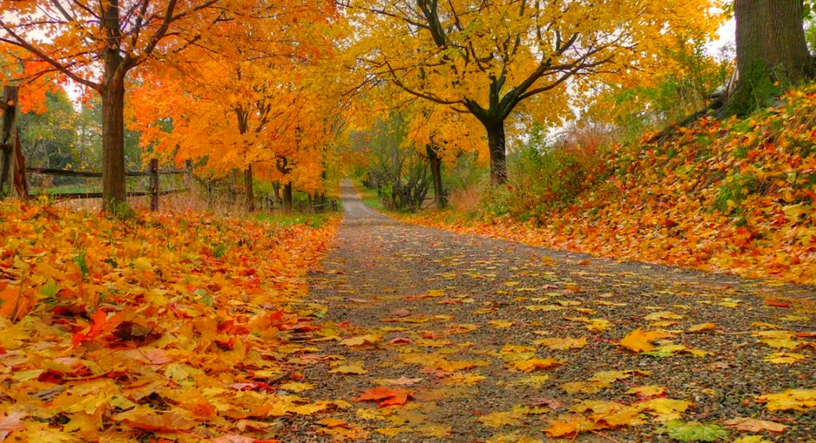
The leaves in the trees are yellow, orange and red; birds fly away.

Slide 13
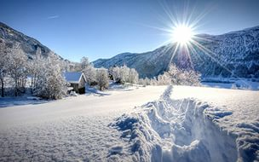
December, January and February are winter months.

Slide 14
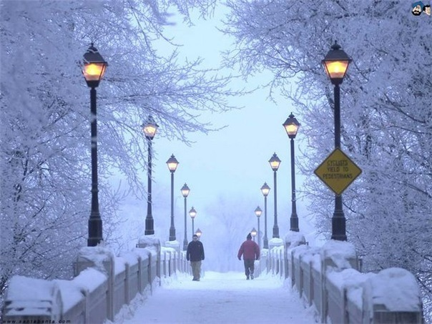
The weather in winter is cold and snowy.

Slide 15
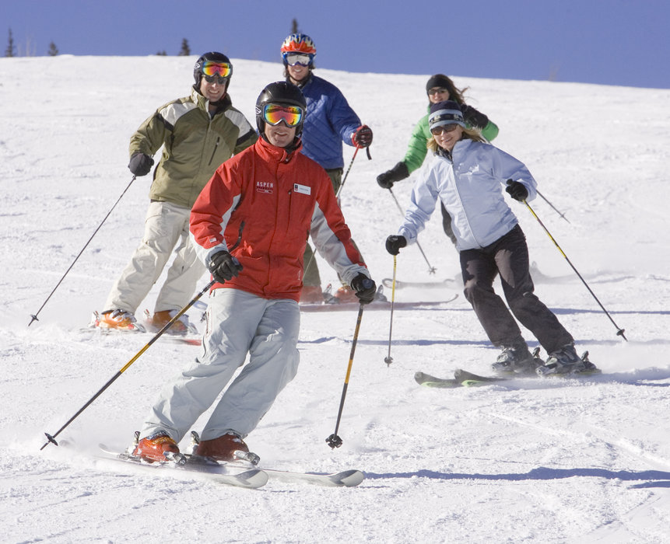
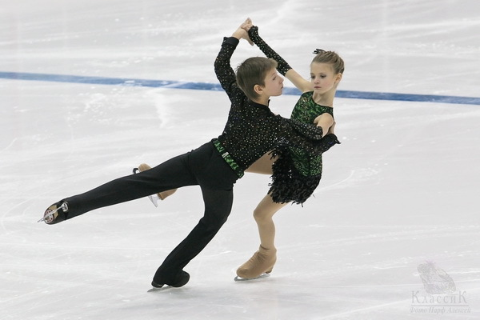
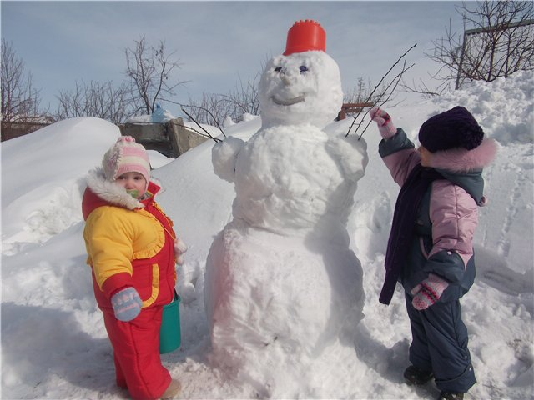
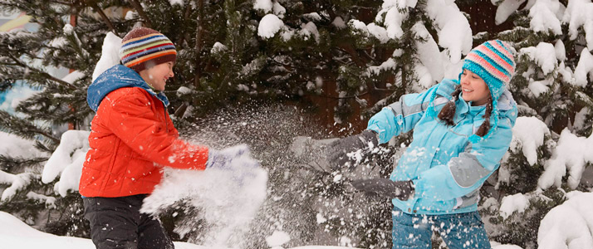
Children like winter: we can ski, skate, play snowballs and make snowmen.

Slide 16
Spring is green, Summer is bright, Autumn is yellow, Winter is white.

