Slide 1
The World of Painting

Slide 2
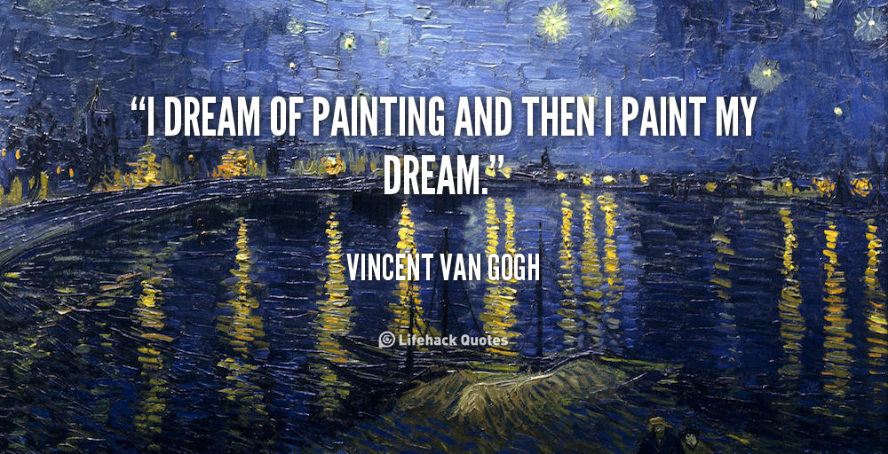

Slide 3
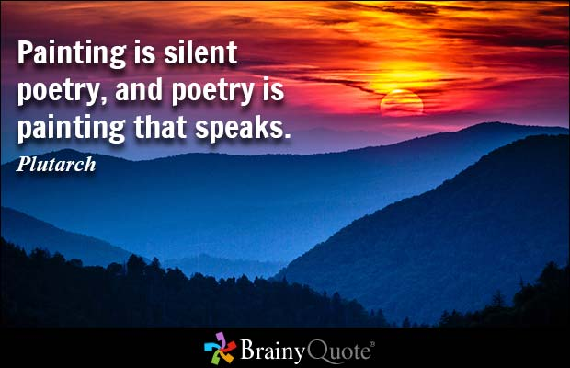

Slide 4
Quotations about Painting

Slide 5
Art plays an important role in our life. It aids the people`s understanding of their culture. No doubt tastes should be developed through images of high artistic culture, whereas works of popular culture as a rule meet consumers tastes.

Slide 6
In my opinion the habit of looking at good pictures is in itself a means by which taste can be formed. Art allows people to talk about emotionally meaningful experiences.

Slide 7
Every artist tries to develop his own style of painting to differ from other ones. There are many styles of painting in art: a portrait, a still life, a landscape, a seascape and etc.

Slide 8
Portrait Painting
A portrait is an image of a person or animal. Besides showing what someone looks like, a portrait often captures a mood or personality.

Slide 9
Still-life Painting
A still life shows objects, such as flowers, food, or musical instruments. A still life reveals an artist's skill in painting shapes, light, and shadow.

Slide 10
Landscape Painting
A landscape is an outdoor scene. A landscape artist uses paint to create not only land, water, and clouds but air, wind, and sunlight.

Slide 11
Real life Painting
A real life scene captures life in action. It could show a busy street, a beach party, a dinner gathering, or anyplace where living goes on.

Slide 12
Religious Painting
A religious work of art shares a religious message. It might portray a sacred story or express an artist's faith.

Slide 14
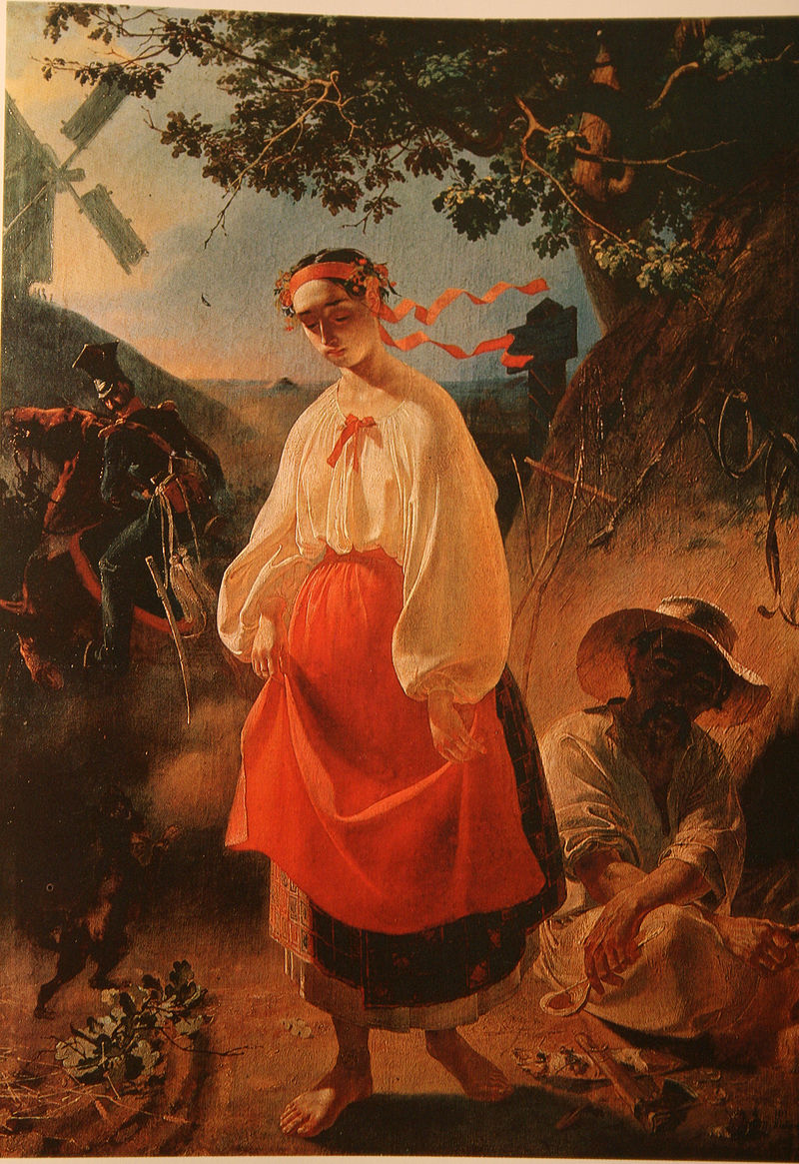
Ukrainian Painters (XIX – XX centuries)
Taras Shevchenko
“Catherine”
M. Pymonenko
“To the Water”

Slide 15
Сontemporary Ukrainian Art Vasyl Kushch, Ukrainian artist

Slide 16
"THE EARTH" (ZEMLIIA) BY BOHDAN PEVNY Dedicated to the Memory of the 1933 Famine in Ukraine

Slide 17
The Art Inspired by Ukraine's Euromaidan When Kiev's Independence Square becomes a studio.
The anonymous author says his painting represents Ukraine today. "Ukrainians showed people of other countries that we are not afraid of anything. When the situation become very difficult, nobody surrenders," he wrote.

Slide 18
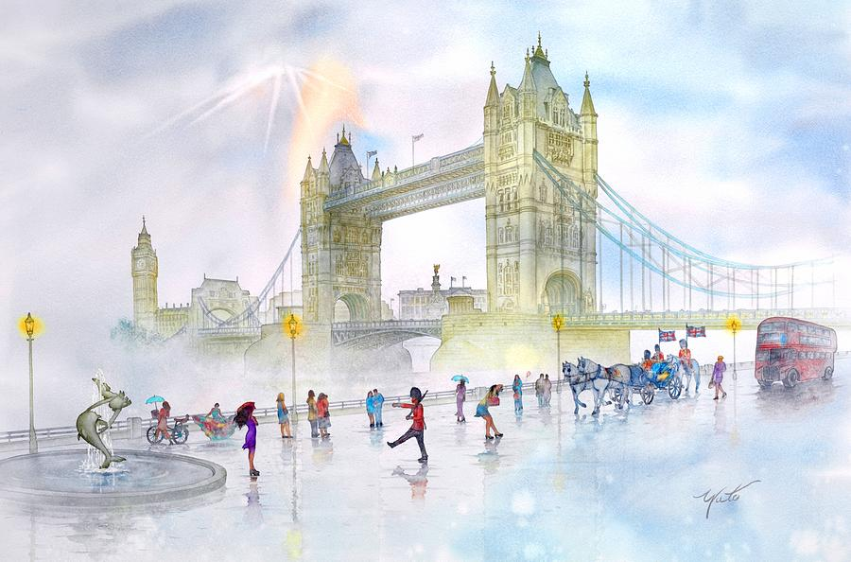
English Painters

Slide 19
William Hogarth

Slide 20
Thomas Gainsborough

Slide 21
Reynolds Sir Joshua

Slide 22
An artist has the skill to combine form and colour into harmonious entity and to represent a brilliant colour scheme. The artists pictures may be dull, crude, chaotic and colourless daub of paint. But in spite of it they are an exquisite piece of painting.

