Slide 1
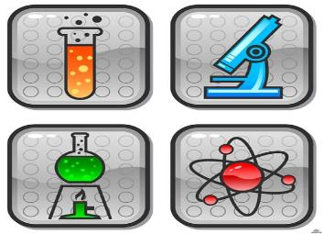
Inventions and Inventors

Slide 2
Finish the Quotations:
1) Genius is one per cent inspiration and ninety-nine per cent perspiration. (T. Edison)
2) You cannot teach a man anything; you can only help him find it within himself. (Galileo)
3) It is better to understand a little, than to misunderstand a lot.
4) Wonders are many and nothing is more wonderful than man. (Sophocles)
5) We know what we are but we know not what we may be. (Shakespeare)
6) Imagination is more important than knowledge. (A. Einstein)
7) Men learn while they teach.
8) Train hard, fight easy.
9) Necessity is the mother of invention.

Slide 3
Do You Know These Devices?
record moving pictures;
play games;
add numbers;
play music;
send messages;
speak to people;
listen to the news.
1.
3.
4.
2.
5.

Slide 4
Match the early devices with the modern ones
Adding machine
Telegraph
Crystal radio
Gramophone
Typewriter
Cine camera
Video game
Instamatic camera
CD player
camcorder
calculator
digital camera
telephone
games console
DAB radio
word processor

Slide 6
Alexander Graham Bell (1847 – 1922)
Alexander Graham Bell was an eminent scientist, inventor, engineer and innovator who is credited with inventing the first practical telephone. His research on hearing and speech led him to experiment with hearing devices which eventually culminated in Bell being awarded the first U.S. patent for the telephone in 1876.

Slide 7
Joseph Nicephore Niepce
(1765-1833)
Joseph Nicéphore Niépce was a French inventor, most noted as one of the inventors of photography and a pioneer in the field. He is well-known for taking some of the earliest photographs, dating to the 1820s. As revolutionary as his invention was, Niépce is little known even today.

Slide 8
Alexander Fleming (1881 – 1955)
Sir Alexander Fleming was a Scottish biologist and pharmacologist. His best-known achievements are the discovery of the enzyme lysozyme in 1923 and the antibiotic substance penicillin from the fungus Penicillium notatum in 1928, for which he shared the Nobel Prize in Physiology or Medicine in 1945 with Howard Walter Florey and Ernst Boris Chain.

Slide 10
Thomas Edison (1847-1931)

Slide 12
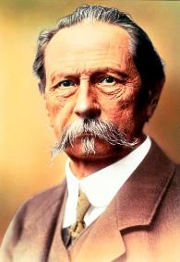
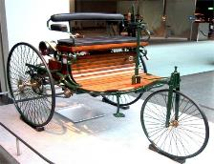
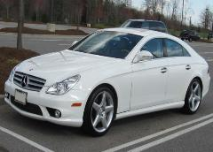
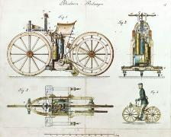
Karl Friedrich Benz (1844 – 1929)
Karl Friedrich Benz was a German engine designer and automobile engineer, generally regarded as the inventor of the petrol-powered automobile and pioneering founder of the automobile manufacturer, Mercedes-Benz.

Slide 13
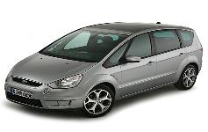
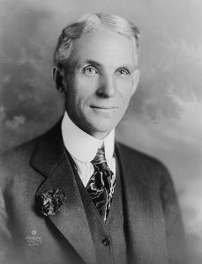
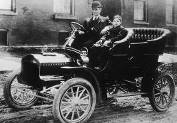
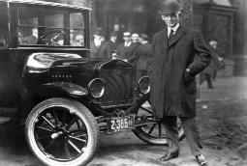
Henry Ford
(1863-1947)
Henry Ford was born in 1863. He was a man who transformed the world. The car he built changed the lives of people everywhere. In 1896, Ford succeeded in building an automobile powered by a gasoline engine. He built this engine in his kitchen sink. In 1903, Henry Ford founded the Ford Motor Company and introduced the Model T Ford.
Henry Ford wanted to make a car that everyone would be able to afford. He lowered the price of the Model T by introducing mass production assembly techniques.

Slide 14
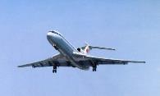
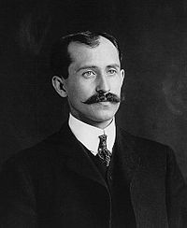
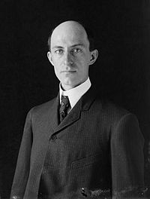
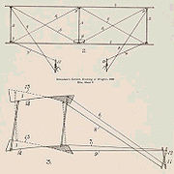
The Wright brothers: Orville (1871 – 1948) Wilbur (1867 – 1912)
The Wright brothers were two Americans who are generally credited with inventing and building the world's first successful airplane and making the first controlled, powered and sustained heavier-than-air human flight, on December 17, 1903. In two years afterward, the brothers developed their flying machine into the first practical fixed-wing aircraft. The Wright brothers were the first to invent aircraft controls that made fixed-wing flight possible.

Slide 16
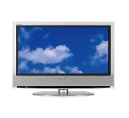
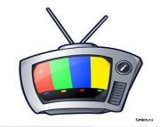
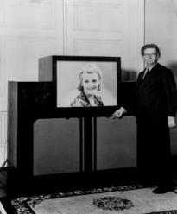
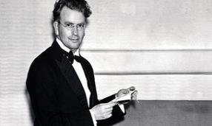
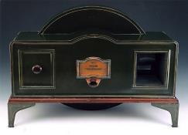
John Logie Baird (1888 – 1946)
John Logie Baird was a British engineer and inventor of the world's first working television system, also the world's first fully electronic colour television broadcast. Although Baird's electromechanical system was eventually displaced by purely electronic systems his early successes demonstrating working television broadcasts and his colour and cinema television work earn him a prominent place in television's invention.

Slide 17
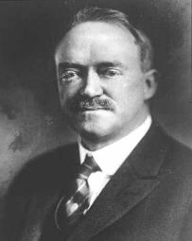
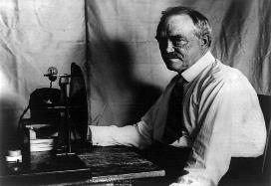
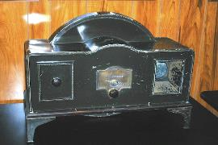
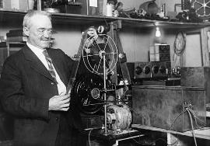
Charles Francis Jenkins
(1867-1934)
Charles Francis Jenkins was working on his design of mechanical television in Washington. In June, 1925, he demonstrated publicly a synchronized image and sound transmission.

Slide 18
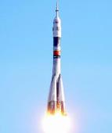
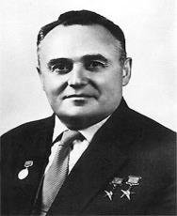
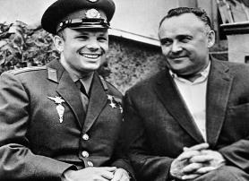
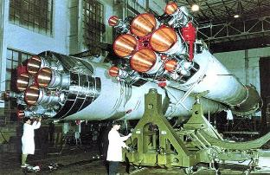
Sergiy Pavlovych Korolyov (1907 – 1966)
Sergiy Pavlovych Korolyov was the head Soviet rocket engineer and designer during the Space Race between the United States and the Soviet Union in the 1950s and 1960s. He is considered by many as the father of practical astronautics.

Slide 20
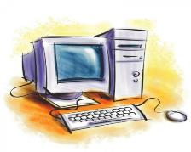
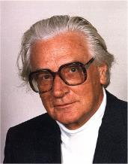
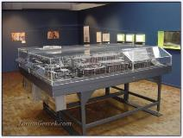
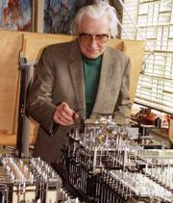
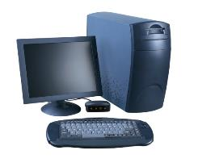
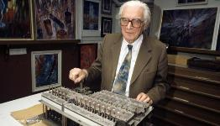
Konrad Zuse
(1910-1995)
Konrad Zuse was a German engineer and computer pioneer. He earned the semiofficial title of the “inventor of the modern computer” for his series of automatic calculators, which he invented to help him with his lengthy engineering calculations. His greatest achievement was the world's first functional program-controlled computer, the Z3, in 1941. In addition to his technical work, Zuse founded the first computer startup company in 1946.

Slide 21
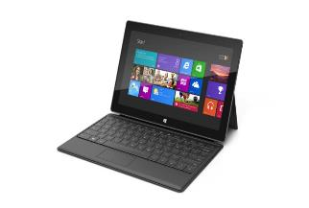
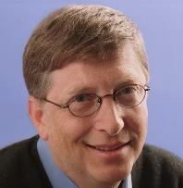
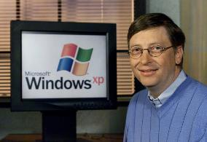
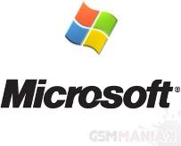
William Henry
“Bill” Gates III
William Henry "Bill" Gates III is an American business magnate, philanthropist, and chairman of Microsoft, the software company. During his career at Microsoft, Gates held the positions of CEO and chief software architect, and remains the largest individual shareholder. Gates is one of the best-known entrepreneurs of the personal computer revolution.

Slide 22
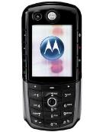
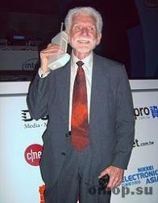
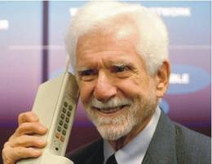
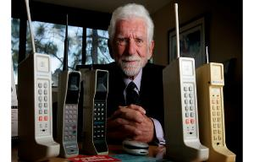
Martin Cooper
(born December 26,1928)
Martin Cooper is an American pioneer in the wireless communications industry. With eleven patents in the field, he is recognized as an innovator in radio spectrum management.
While at Motorola in the 1970s, Cooper conceived the first handheld mobile phone and led the team that developed it and brought it to market. He is considered the "father of the cell phone" and is also cited as the first person in history to make a handheld cellular phone call in public.

Slide 24
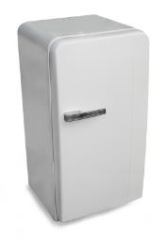
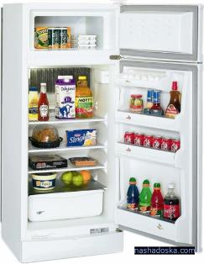
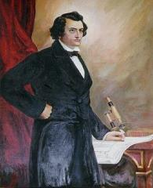
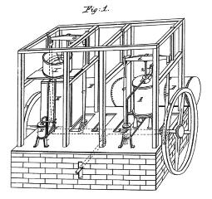
John Gorrie (1803 – 1855)
John Gorrie (1803-1855) was granted the first U.S.patent for mechanical refrigeration. As a physician in Florida during the outbreak of the malaria epidemic, Gorrie set about on his mission to create artificial cooling as a matter of medical urgency to cure his patients of a disease he believed was caused by extreme heat and humidity.

Slide 25
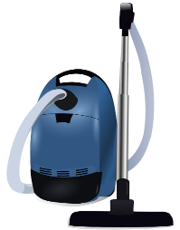
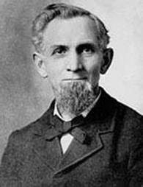
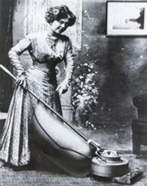
James Murray Spangler
(1848-1915)
J. M. Spangler was an American inventor, salesman and janitor who invented the first commercially successful portable electric vacuum cleaner that revolutionized household carpet cleaning. His device was not the first vacuum cleaner. However, Spangler’s device was the first that was practical for home use. It was the first to use both a cloth filter bag and cleaning attachments. Spangler improved this basic model and received a patent for it in 1908.

