Slide 1



Funny Animals

Slide 2
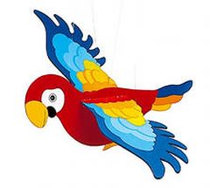
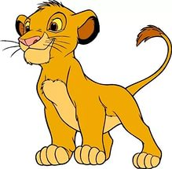

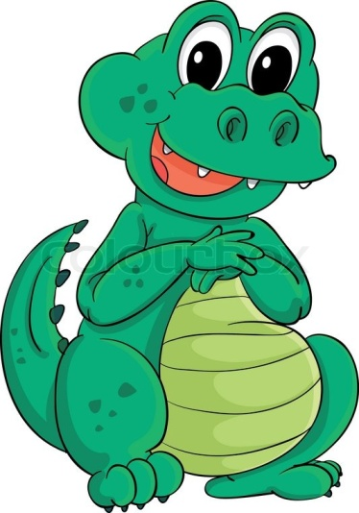
2
1
4
3
5

Slide 3
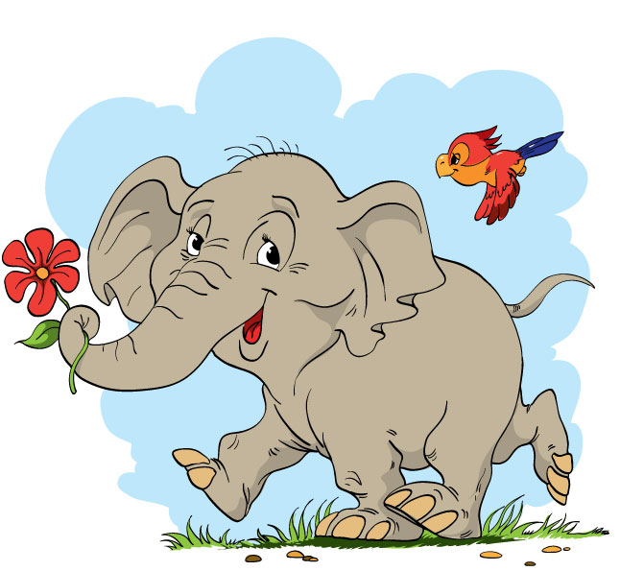
Who is it?
e
l
e
p
h
a
n
t

Slide 4

Who is it?
c
r
e
o
l
c
e
o
p
d
h
i
a
l
n
e
t

Slide 5
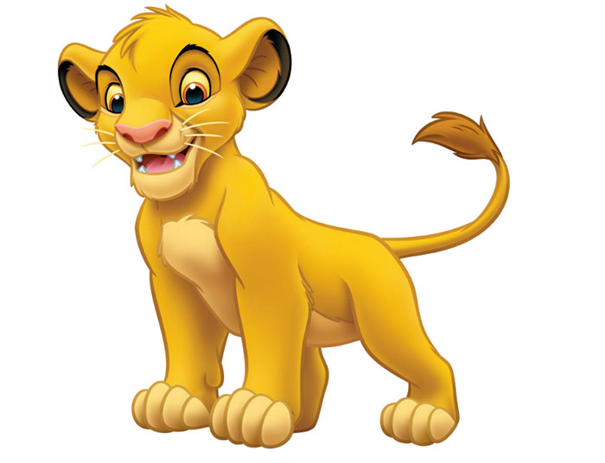
Who is it?
c
r
e
o
l
c
e
o
p
d
h
i
a
l
i
o
n
e
t

Slide 6
Who is it?
c
r
e
o
l
c
e
o
p
a
r
r
o
t
d
h
i
a
l
i
o
n
e
t

Slide 7

Who is it?
c
r
e
o
l
c
e
o
p
a
r
r
o
t
d
h
i
a
l
i
o
n
e
t
i
g
e
r

Slide 8
GOOD WORK
c
r
e
o
l
c
e
o
p
a
r
r
o
t
d
h
i
a
l
i
o
n
e
t
i
g
e
r

