Slide 1
ЩОДЕННІ 3
«3имові завдання від Діда Мороза» з математики
2 клас

Slide 2
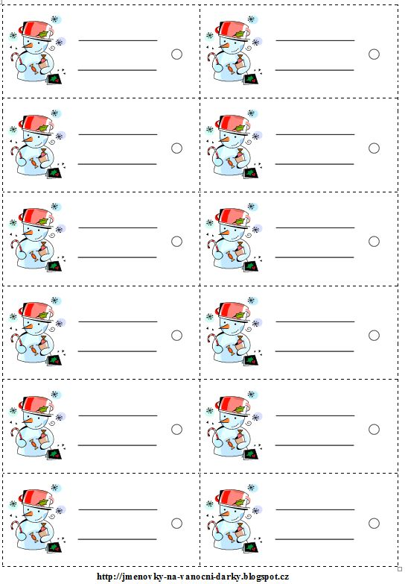
92 – 36 =
(28 +35) – 47 =
70 - 27 =
56 – 43 + 26 =
80 – 54 =
92 – 36 =
(28 +35) – 47 =
70 - 27 =
56 – 43 + 26 =
80 – 54 =
92 – 36 =
(28 +35) – 47 =
70 - 27 =
56 – 43 + 26 =
80 – 54 =
92 – 36 =
(28 +35) – 47 =
70 - 27 =
56 – 43 + 26 =
80 – 54 =
92 – 36 =
(28 +35) – 47 =
70 - 27 =
56 – 43 + 26 =
80 – 54 =
92 – 36 =
(28 +35) – 47 =
70 - 27 =
56 – 43 + 26 =
80 – 54 =
92 – 36 =
(28 +35) – 47 =
70 - 27 =
56 – 43 + 26 =
80 – 54 =
92 – 36 =
(28 +35) – 47 =
70 - 27 =
56 – 43 + 26 =
80 – 54 =
92 – 36 =
(28 +35) – 47 =
70 - 27 =
56 – 43 + 26 =
80 – 54 =
92 – 36 =
(28 +35) – 47 =
70 - 27 =
56 – 43 + 26 =
80 – 54 =
92 – 36 =
(28 +35) – 47 =
70 - 27 =
56 – 43 + 26 =
80 – 54 =
92 – 36 =
(28 +35) – 47 =
70 - 27 =
56 – 43 + 26 =
80 – 54 =

Slide 3
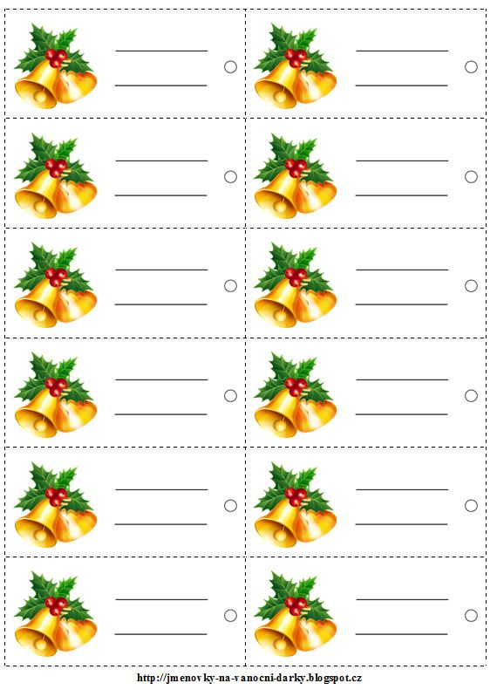

Slide 4
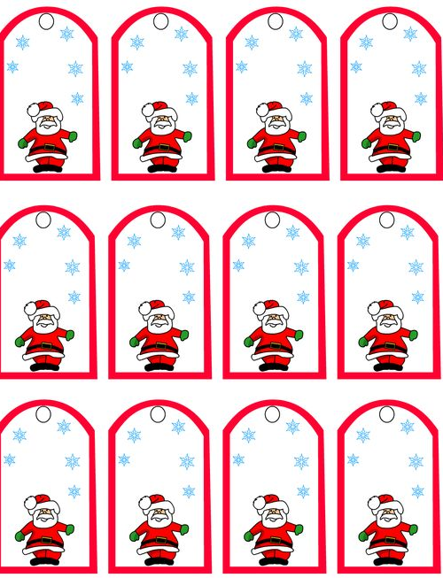

Slide 5
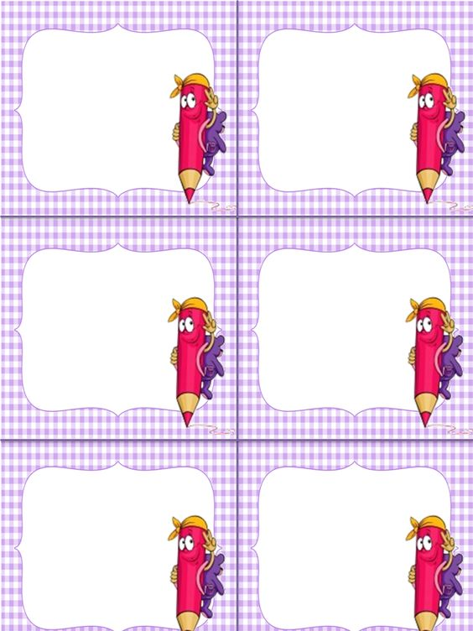
28 – (7 +5) =
86 – 50 – 5 =
23 +23 -20 =
28 – (7 +5) =
86 – 50 – 5 =
23 +23 -20 =
28 – (7 +5) =
86 – 50 – 5 =
23 +23 -20 =
28 – (7 +5) =
86 – 50 – 5 =
23 +23 -20 =
28 – (7 +5) =
86 – 50 – 5 =
23 +23 -20 =
28 – (7 +5) =
86 – 50 – 5 =
23 +23 -20 =

Slide 6
92 – 28 – 33 =
56 + 13 =
54 – 17 =
92 – 28 – 33 =
56 + 13 =
54 – 17 =
92 – 28 – 33 =
56 + 13 =
54 – 17 =
92 – 28 – 33 =
56 + 13 =
54 – 17 =
92 – 28 – 33 =
56 + 13 =
54 – 17 =
92 – 28 – 33 =
56 + 13 =
54 – 17 =
92 – 28 – 33 =
56 + 13 =
54 – 17 =
92 – 28 – 33 =
56 + 13 =
54 – 17 =
92 – 28 – 33 =
56 + 13 =
54 – 17 =
92 – 28 – 33 =
56 + 13 =
54 – 17 =
92 – 28 – 33 =
56 + 13 =
54 – 17 =
92 – 28 – 33 =
56 + 13 =
54 – 17 =

Slide 7
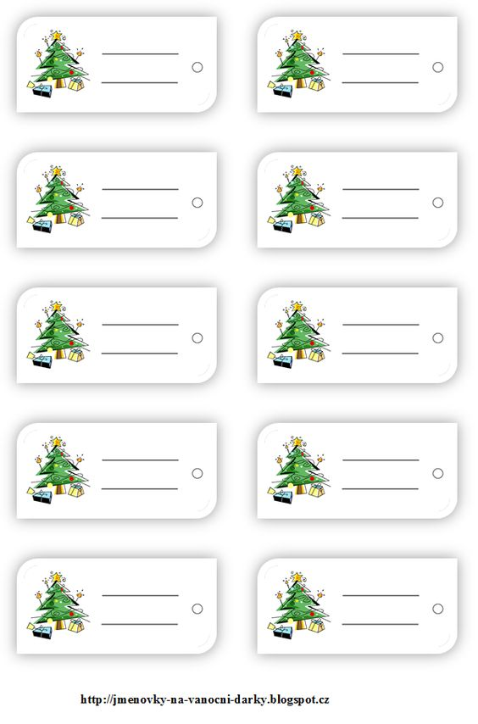
(5 +8 ) +6 =
56 + ( 9 + 6) =
16 – (8 + 4) =
24 +24 -30 =
(5 +8 ) +6 =
56 + ( 9 + 6) =
16 – (8 + 4) =
24 +24 -30 =
(5 +8 ) +6 =
56 + ( 9 + 6) =
16 – (8 + 4) =
24 +24 -30 =
(5 +8 ) +6 =
56 + ( 9 + 6) =
16 – (8 + 4) =
24 +24 -30 =
(5 +8 ) +6 =
56 + ( 9 + 6) =
16 – (8 + 4) =
24 +24 -30 =
(5 +8 ) +6 =
56 + ( 9 + 6) =
16 – (8 + 4) =
24 +24 -30 =
(5 +8 ) +6 =
56 + ( 9 + 6) =
16 – (8 + 4) =
24 +24 -30 =
(5 +8 ) +6 =
56 + ( 9 + 6) =
16 – (8 + 4) =
24 +24 -30 =
(5 +8 ) +6 =
56 + ( 9 + 6) =
16 – (8 + 4) =
24 +24 -30 =
(5 +8 ) +6 =
56 + ( 9 + 6) =
16 – (8 + 4) =
24 +24 -30 =

Slide 8
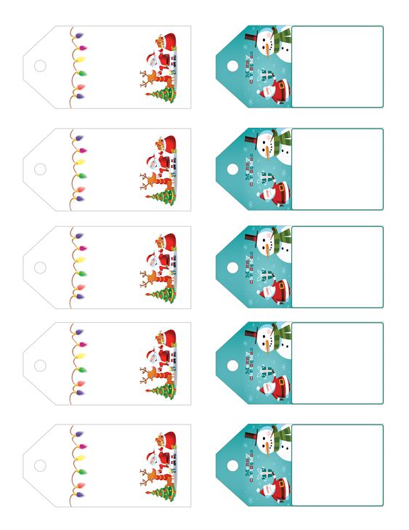
39 + 5
82 + 9
18 + 5
78 + 6
(8 + 5) +23 =
16 + (6 + 8) =
39 – (8 + 4) =
9 + 7 +60 =
39 + 5
82 + 9
18 + 5
78 + 6
(8 + 5) +23 =
16 + (6 + 8) =
39 – (8 + 4) =
9 + 7 +60 =
39 + 5
82 + 9
18 + 5
78 + 6
(8 + 5) +23 =
16 + (6 + 8) =
39 – (8 + 4) =
9 + 7 +60 =
39 + 5
82 + 9
18 + 5
78 + 6
(8 + 5) +23 =
16 + (6 + 8) =
39 – (8 + 4) =
9 + 7 +60 =
39 + 5
82 + 9
18 + 5
78 + 6
(8 + 5) +23 =
16 + (6 + 8) =
39 – (8 + 4) =
9 + 7 +60 =

Slide 9
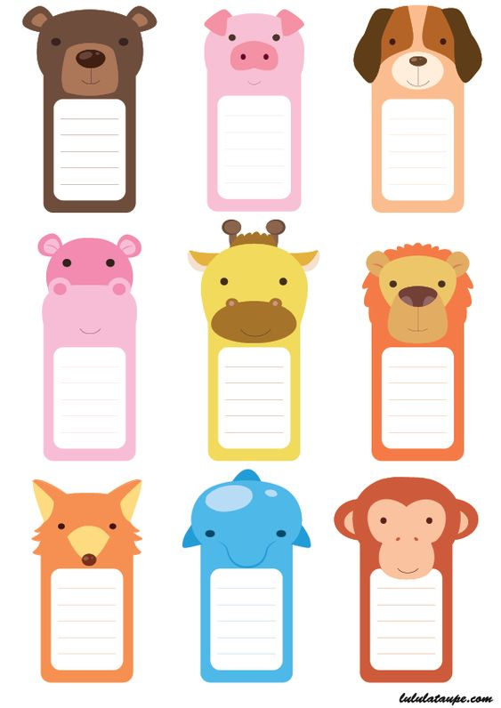

Slide 10
