Slide 1
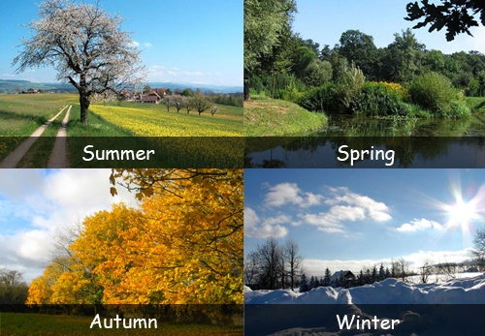
Seasons of the Year

