Slide 1
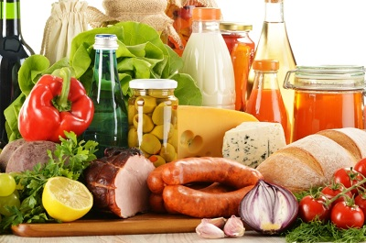
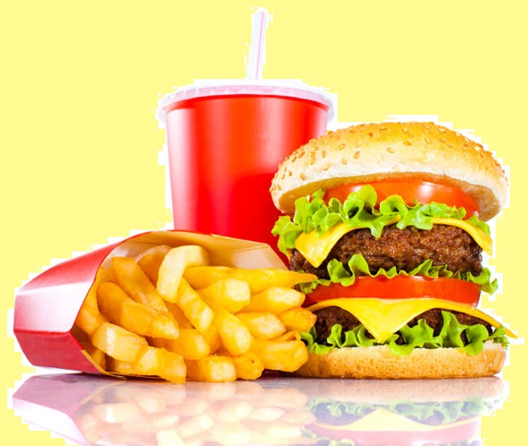
Food

Slide 2
Hello, dear boys and girls!
I’m glad to see you!

Slide 3
Vocabulary Drills Find an eхtra word 1. Tea, sausage, meat, fish. 2. Fried potatoes, apple, plum, peach. 3. Lunch, dinner, breakfast, cheese.

Slide 4
Exercise 1,2 page 98 Vocabulary Work
carrot
tomato
peas
spinach
strawberry
pear
watermelon
cabbage
cherry
sugar
jam
milk
tea
honey
butter
butter
bacon
eggs
cornflakes
cheese

Slide 5
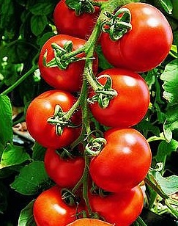
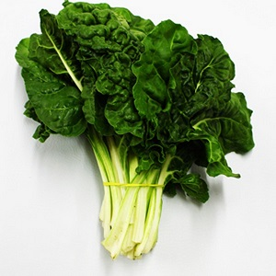
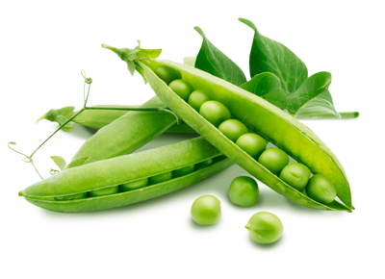
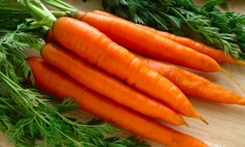
Exercise 4, page 99
Exercise 3, page 99

Slide 6
Make up sentences 1. People, live, cannot, food, without. 2. Meat, fish, milk, you, help, to, grow. 3. Bread, sugar, cheese, you, give, energy.
4. Vegetables, eggs, your, bones, make, teeth, strong. 5. Fruit, vegetables, got, have, a lot of, vitamins. 6. Vitamins, important, are, for, body, our. 7. Eat, food, the right.

Slide 7
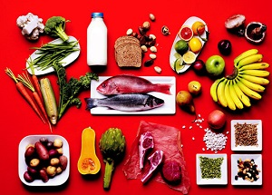
Say about Healthy Food Habits

Slide 8
Homework
Exercises 1, 2,
page 100 – 101;
vocabulary: page 101;
prepare to the Reading Test

