Slide 1
My family

Slide 2
Present Continuous Tense page 95
to be: am, is, are + V -ing
+ | I You /we / they He / she / it | am / ‘m are /’re is / ‘s | read | -ing
▬ | I You /we / they He / she / it | am not / ‘m not are not / aren’t is not /isn’t

Slide 3
to be: am, is, are + V -ing
? | Am Are Is | I you /we / they he / she / it | read | -ing
Short ans. | Yes, No, Yes, No, Yes, No, | I I You / we / they You / we / they He / she / it He / she / it | am. am not. are. are not / aren’t. is. is not / isn’t.

Slide 4
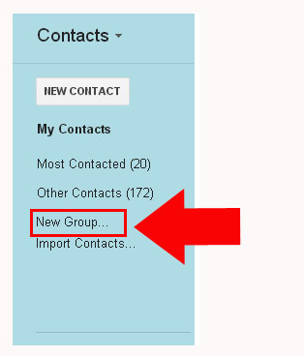
Exercise 1, pages 95 – 96

Slide 5
Listening Exercise 1, page 96
What are you doing now?
What is she doing now?

Slide 6
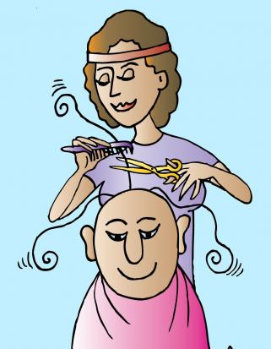
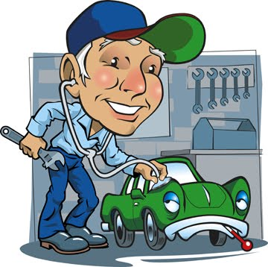
Vocabulary Work page 97
computer programmer
cook
hairdresser
mechanic
taxi driver
writer

Slide 7
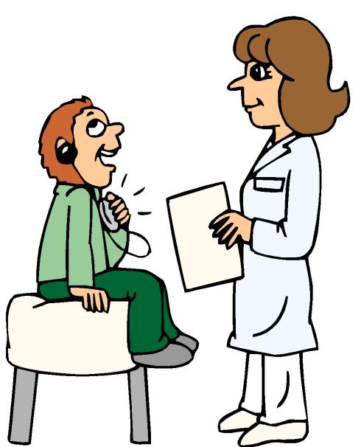
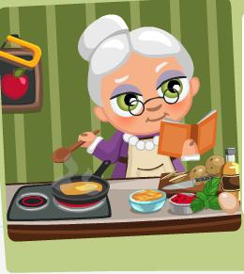
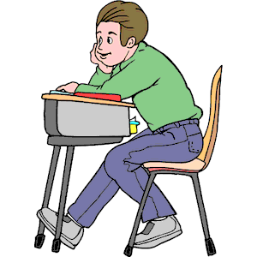
Pairs Work Exercise 2, page 97

Slide 8
Homework
Exercises 1, 2,
page 97;

