Slide 1
My new friends

Slide 2
Grammar Table page 12
Subject Pronouns | Possessive Pronouns
I You He/she/it We You They | My Your His/her/its Our Your Their

Slide 3
Grammar Table page 12
Affirmative | Negative
I’m You’re He’s/she’s/it’s We’re You’re They’re | I’m not You aren’t He isn’t/she isn’t/it isn’t We aren’t You aren’t They aren’t

Slide 4
Exercise 1, page12
Exercise 3, page13

Slide 5
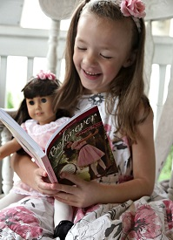
Writing How well you know your friend Use the example and write down about your friend

Slide 6
All about Sally
School: | Sally goes to school № 1. She’s very clever!
Dream: | Sally really wants to be a dentist.
Hobbies: | Sally loves reading and collecting funny dolls.
Secret: | Sally can’t swim. Don’t tell anyone!
Your best friend

Slide 7
Homework Exercises 2, 4,
page 13;

