Slide 1
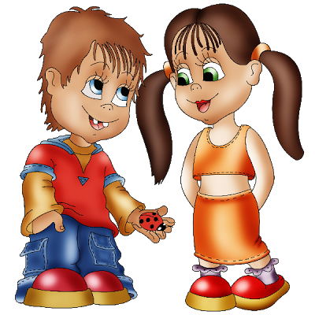
My friend

Slide 2
1. Have you got good friends? 2. Do your friends help you when you are in need? 3. Do your friends think you are a good friend? 4. It is really nice to have good friends, isn’t it? 5. What proverb about good friends do you know?

Slide 3
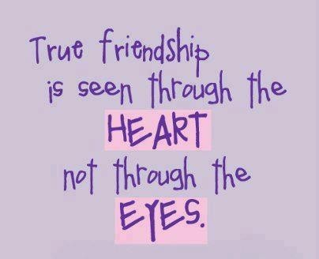
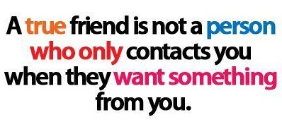
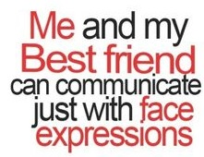

Slide 4
Has | Jane Tina Helen | got | short / long straight / wavy / curly blond / red / black / brown light / dark blue / brown / grey / green | hair? skin? eyes?
Yes, No, | Jane Tina Helen | has got | short / long straight / wavy / curly blond / red / black / brown light / dark blue / brown / grey / green | hair skin eyes

Slide 5
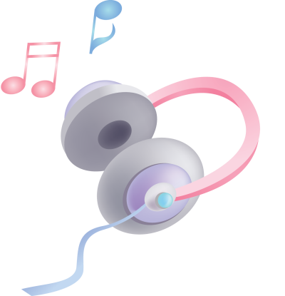
Exercise 1, page 10
Exercise 2, page 11

Slide 6
1. She looks pretty. 2. She is slim and not very tall. 3. She has got straight fair hair. 4. They are much alike. 5. They’ve got light skin. 6. But her mother’s hair is different, it is long and wavy.
Writing Make up sentences
looks pretty
very tall
light skin
alike
slim
straight fair
is different
wavy

Slide 7
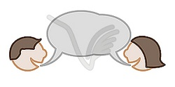
Writing Exercise 3, page 11

