Slide 1
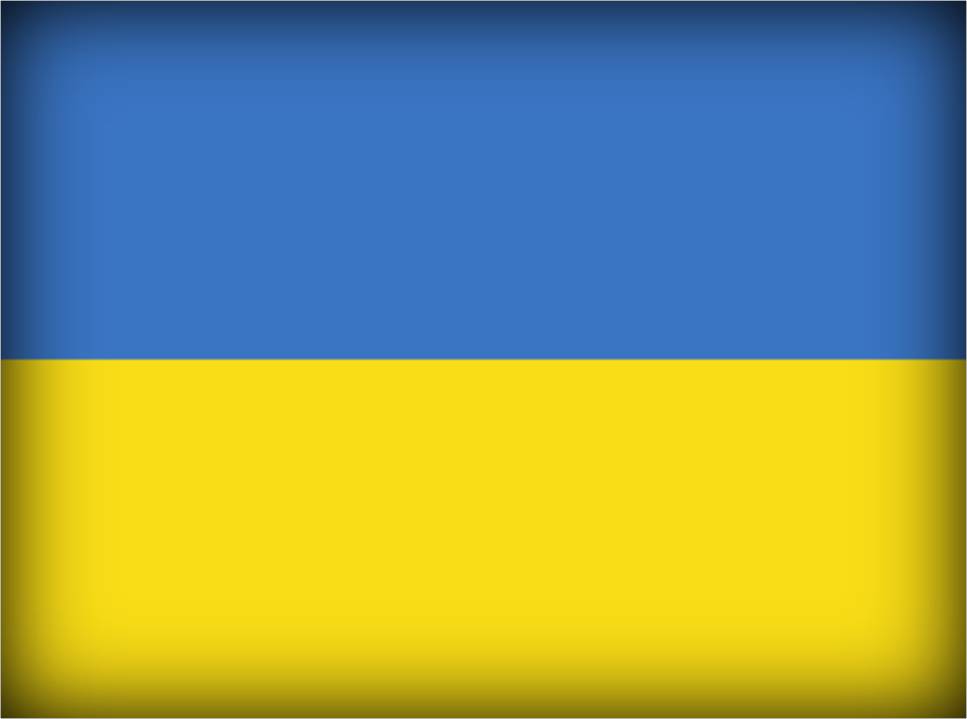
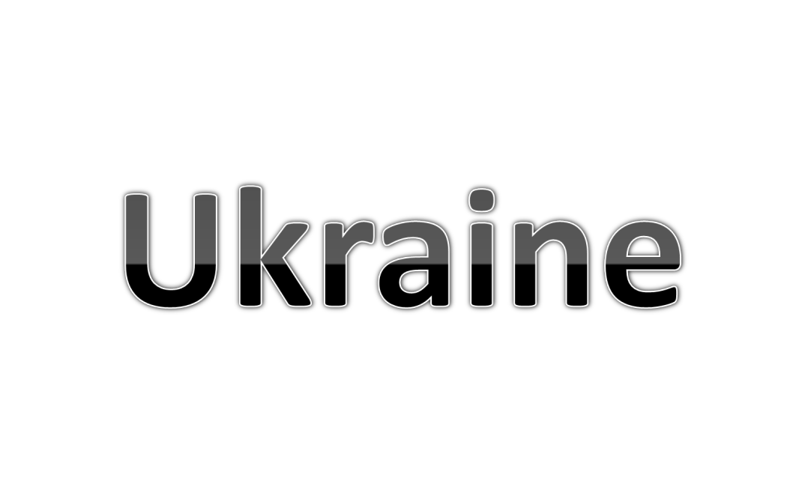

Slide 3
Phonetic drills
Ee [ i: ] see, bee, tree, three, meet, teeth, feet, geese
Ea [ i: ] tea, meat, eat, read, speak, clean
Eig [ eı ] eight, feign, reign, seiner, beige, deign
Ng [ ŋ ] sing, bring, ring, king, long, morning, song
Wh [ w ] when, white, why, which, what, whale,
[ h ] who, whom, whose, wholly, whoop, whoreson

Slide 4
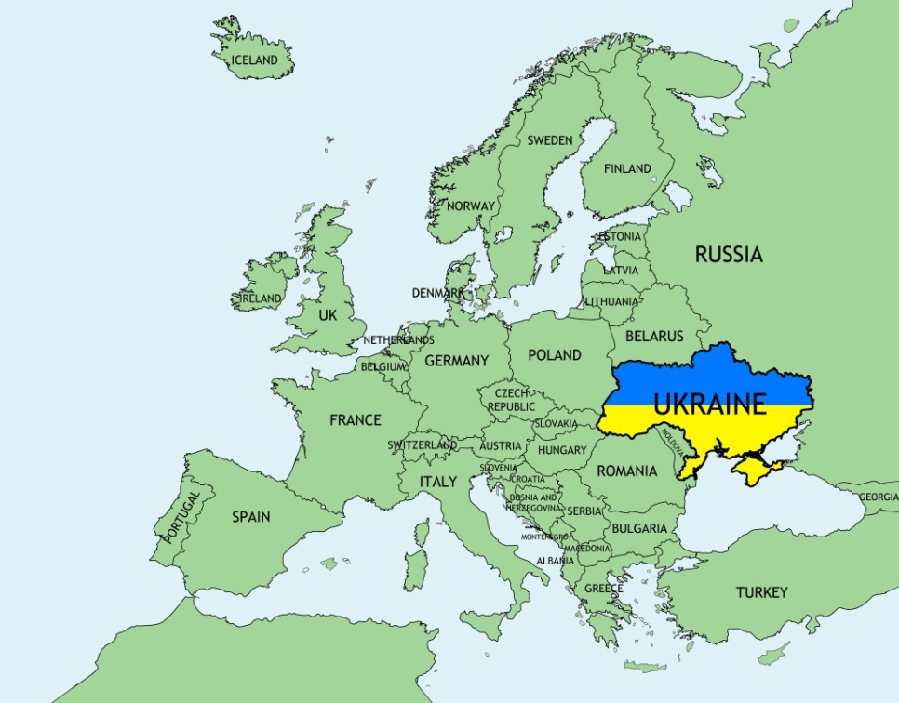
Geographical position
Ukraine is one of the largest countries in Europe. It is situated in the centre of Europe and borders on Russia, Belarus, Moldova, Poland, Slovakia, Hungary and Romania. On the south it is washed by the Black Sea and the Sea of Azov.

Slide 5
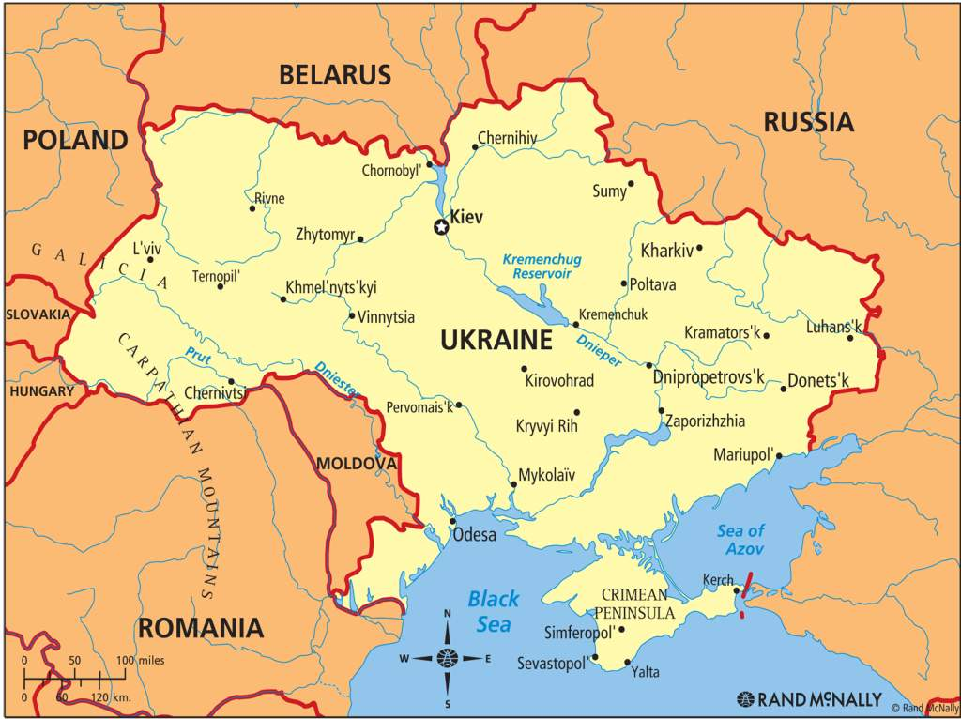

Slide 6
Territory
The major part of the territory is flat and only 5% of the whole territory is mountainous. The two mountainous areas in Ukraine are the Carpathian Mountains and the Crimean Mountains, but they are not very high. The highest mountain is Hoverla.

Slide 7
Rivers
The longest river of Ukraine is the Dnipro. The main rivers are the Dniester, the Buh, the Donets and others.

Slide 8
Climate
The climate of the country is mild and soft in the west and in the centre, warm and dry in the east and hot in the south.

Slide 9
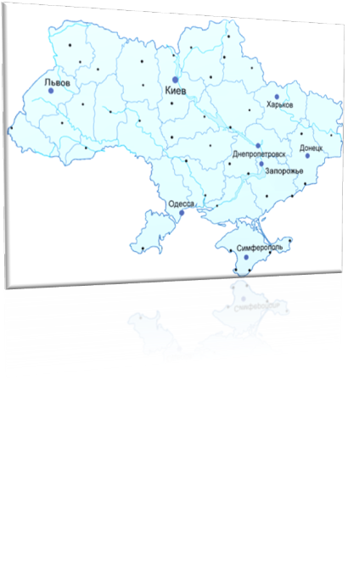
The biggest cities are: Kyiv (population 2.6 million); Kharkiv (population 1.6 million); Dnipro (population 1.1 million); Odesa (population 1.1 million); Donetsk (population 1.1 million), and Lviv (population 802 thousand).

Slide 10
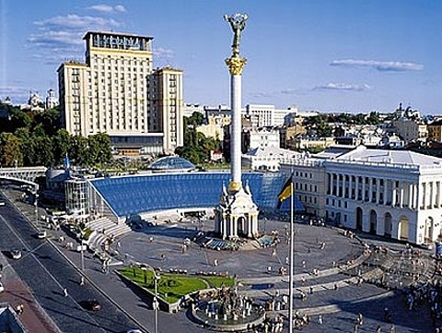
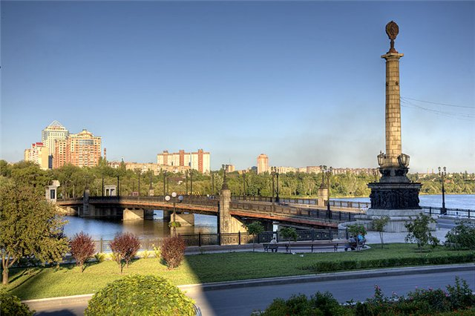
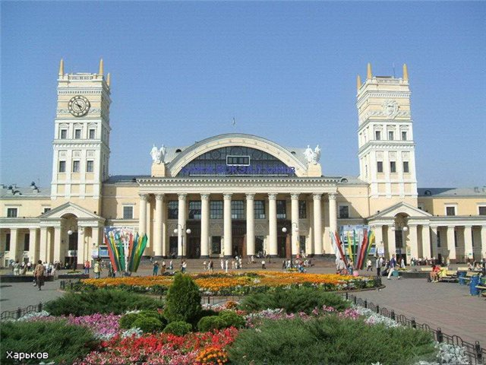
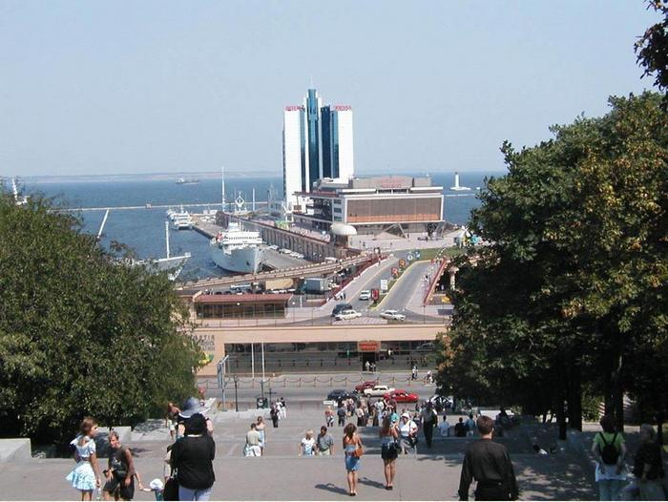
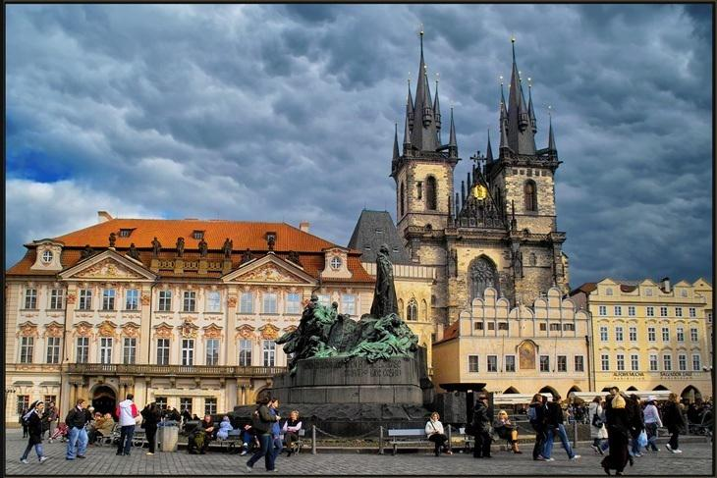
Big Cities
Kyiv
Donetsk
Kharkiv
Odesa
Lviv

Slide 11
National
SYMBOLS
Ukraine is not yet dead, nor it's glory and freedom,
Luck will still smile on us brother-Ukrainians.
Our enemies will die, as the dew does in the sunshine,
And we, too, brothers, we'll live happily in our land.
We'll not spare either our souls or bodies to get freedom
And we'll prove that we brothers are of Kozak kin.
We'll rise up, brothers, all of us, from the Sain to the Don,
We won't let anyone govern in out motherland.
The Black Sea will smile yet, grandfather Dnipro will rejoice,
Yet in our Ukraine luck will be high.
Our persistence, our sincere toil will prove it's rightness,
Still our freedom's loud song will spread throughout Ukraine.
It'll reflect upon the Carpathians, will sound through the steppes,
And Ukraine's glory will arise among the people.

Slide 12
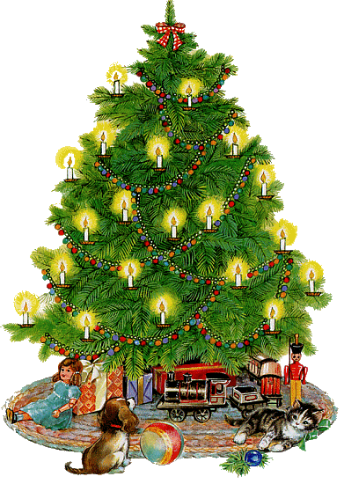
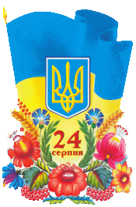
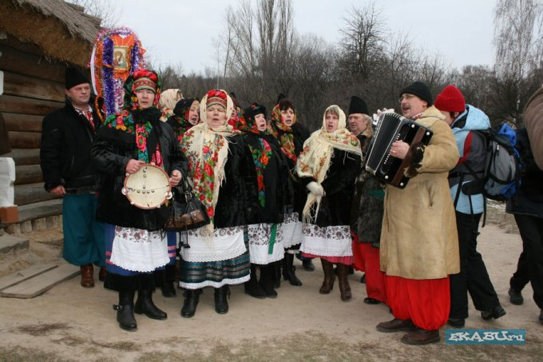
Ukraine Traditions
New Year
Independence
Day
Christmas
Victory Day

Slide 13
What associations do you have
with the word
UKRAINE ?

Slide 14
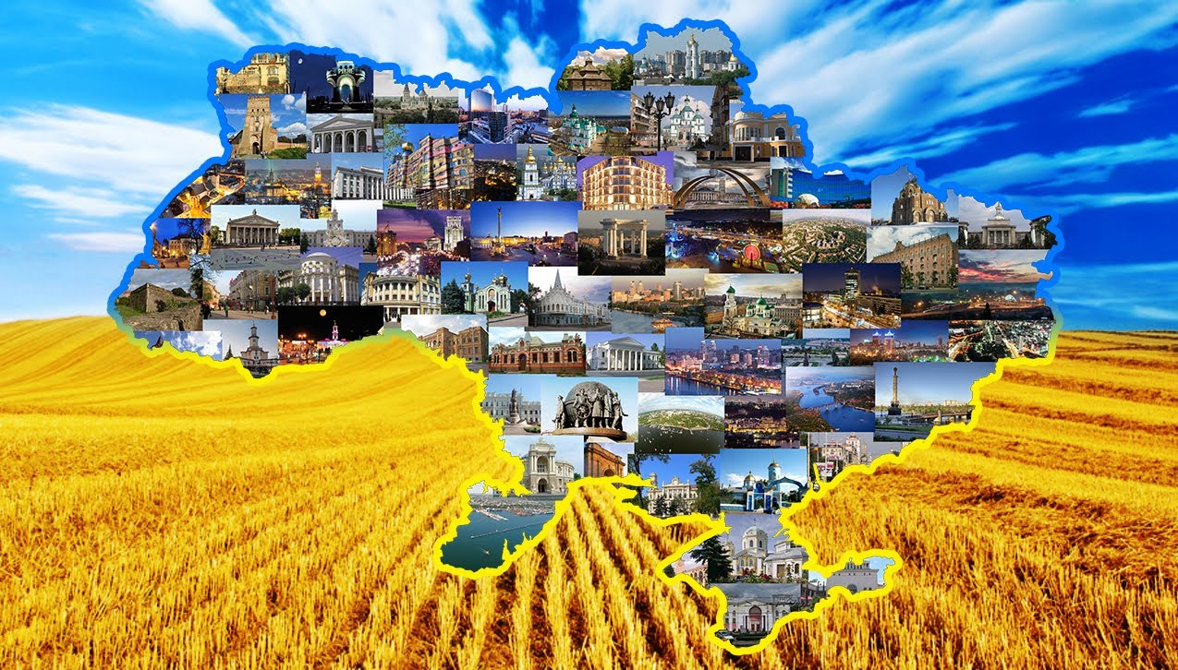
U -
K -
R -
A -
I -
N -
E -

Slide 15
Quiz about Ukraine
The capital of Ukraine is …
My native village is …
The national colours are…
The population of Ukraine is …
The currency of Ukraine is…
Ukraine is a part of …

Slide 16
Answer the questions
Where is Ukraine situated?
What can you say about its geographical position?
Which countries does it border on?
What seas is Ukraine washed by?
What mountains are there on the territory of Ukraine?

Slide 17
My native land,
The land of wonders,
Of autumn rains
And summer thunders.
The greenest hills
And magic lakes,
The tender breeze,
Romantic dales.
Amazing land –
My dear Ukraine.

Slide 18
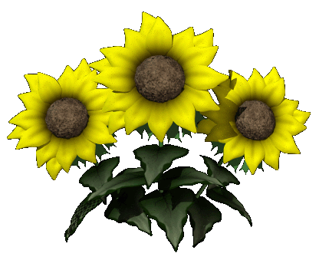
Home task:
learn the poem
learn new words.

