Slide 1
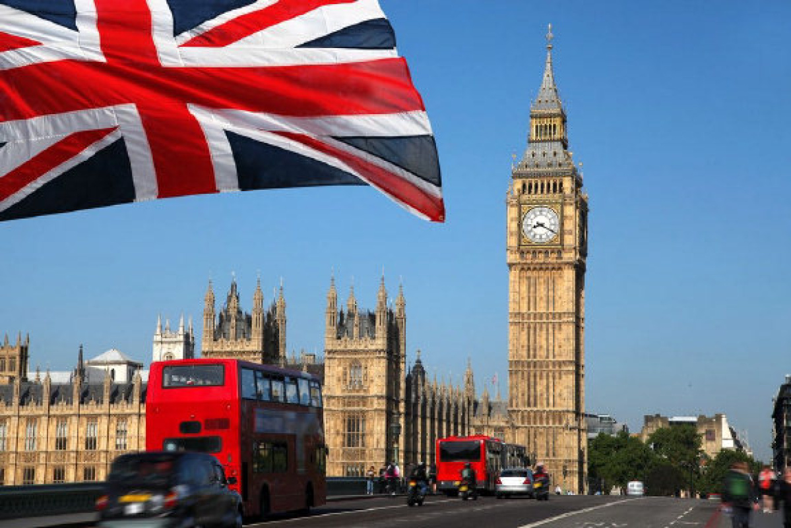

London

Slide 2
If you are tired of London, you are tired of life

Slide 3
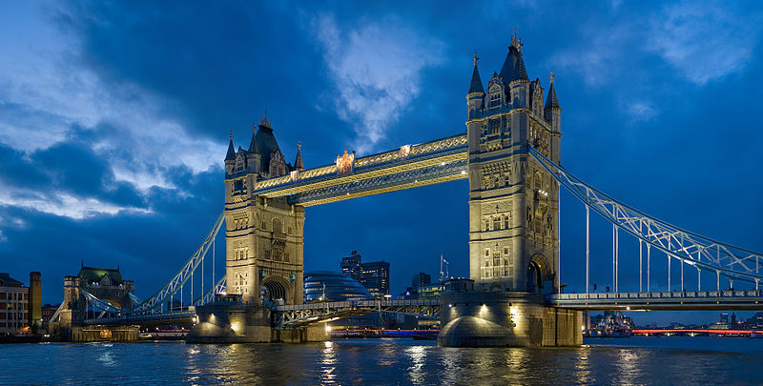
Tower Bridge
Tower Bridge is one of the landmarks of London. Tower Bridge is a fine example of Victorian engineering. This fairy-tale structure was built in 1894. Tower Bridge is the only Thames Bridge which can be raised. The road over the bridge is built on two central sections called bascules, which open two or three times a week to let ships through.

Slide 4
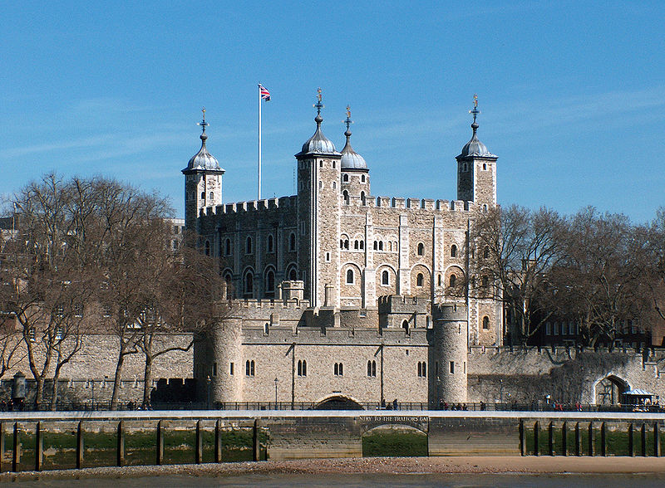
The Tower of London
The Tower of London is the most outstanding link in the chain of the history of the country. William the Conqueror ordered the building of the great stone tower, later called the white Tower. The Tower of London long continued to be both a fortress and a palace. It was also a prison.. But later on, in Tudor times, the Tower became the place where famous and the infamous people were sent.

Slide 5
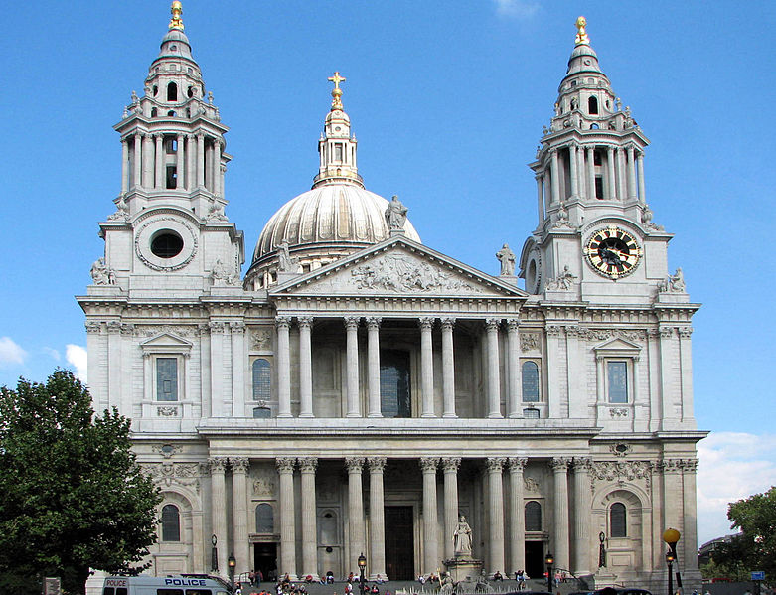
St Paul's Cathedral
St Paul's Cathedral is the fifth church built on the same site. The earliest cathedral was erected in 604. The second, built in stone in 675—685, was burned by the Danes in 962, and the third was destroyed by fire in 1087

Slide 6
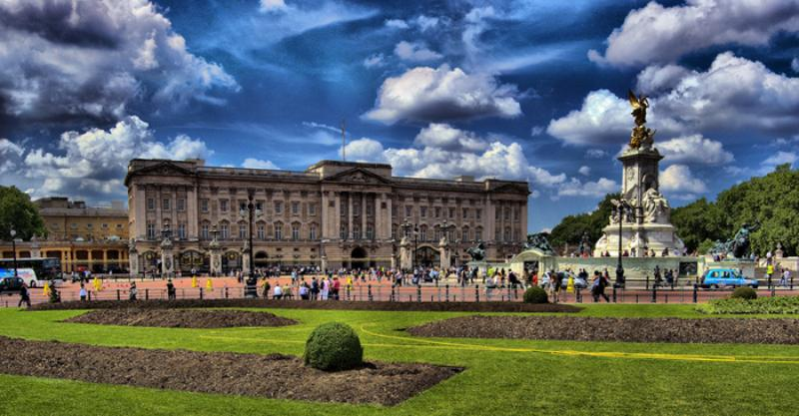
Buckinham Palace
Buckingham Palace is the official London residence of Her Majesty the Queen and her family. It was built in the 18th century and rebuilt later by the architect John Nash.

Slide 7
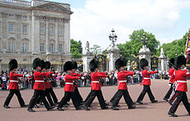
Royal Standard
The Royal Standard flying over the east front of Buckingham Palace is the sign that the Queen is in the residence. The absence of the Royal Standard over Buckingham Palace means that the Queen is absent from London.Buckingham Palace is partially open to the public, but the ceremony of the Changing of the Guard in front of it is a great tourist attraction.

Slide 8
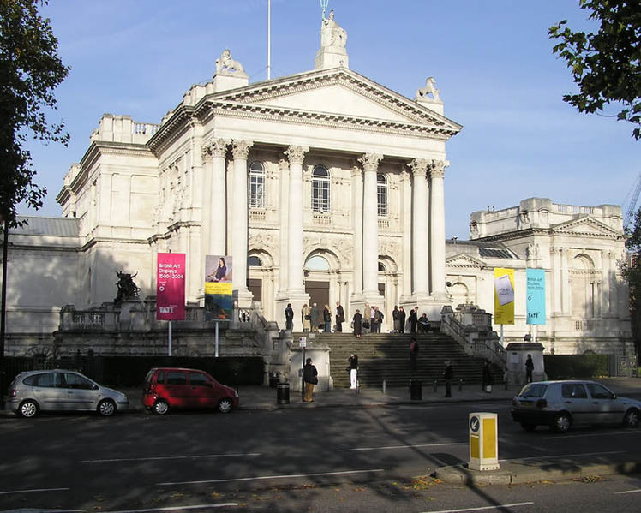
The Tate Gallery
The Tate is an institution that houses the United Kingdom’s national collection of British art, and international modern and contemporary art. It is a network of four art museums: Tate Britain London (until 2000 known as the Tate Gallery, founded 1897), Tate Liverpooll (founded 1988), Tate St Ives, Cornwall(founded 1993) and Tate Modern, London (founded 2000), with a complementary website, Tate Online (created 1998). Tate is not a government institution, but its main sponsor is the Department for Culture, Media and Sport.

Slide 9
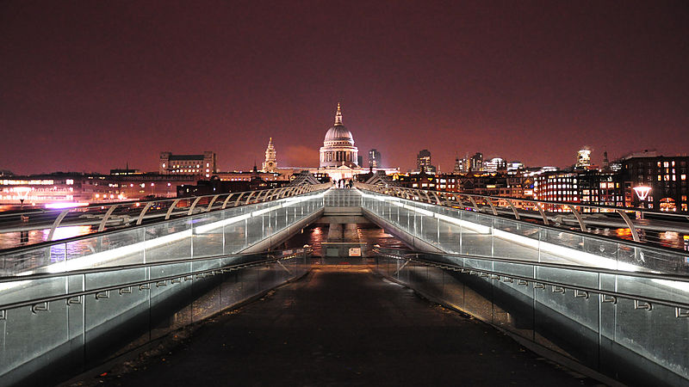
Millenium Bridge at night

Slide 10
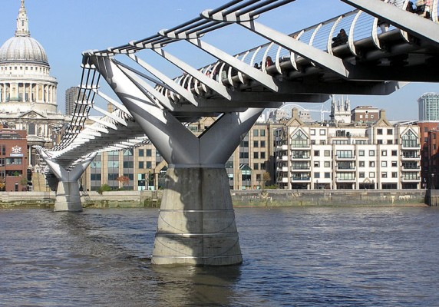
Millenium Bridge
The Millennium Bridge, officially known as the London Millennium Footbridge, is a steel suspension bridge for pedestrians crossing the River Thames in London, linking Bankside with the City of London. It is located between Southwark Bridge and Blackfriars Railway Bridge. It is owned and maintained by Bridge House Estates a charitable trust overseen by theCity of London Corporation.
Londoners nicknamed the bridge the "Wobbly Bridge" after pedestrians felt unexpected swaying motion.

Slide 11
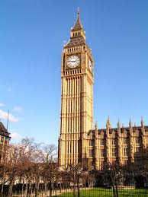
Big Ben
Big Ben is the huge bell in the
clock of Saint Stephen's Tower.
It may have been named after
Sir Benjamin Hall, who
supervised the rebuilding of
Parliament, or after a famous
Victorian prizefighter. Big Ben
has boomed out the hours
since 1859. When Parliament
is sitting at night a light shines
above the clock.

