Slide 1
DO YOU KNOW UKRAINIAN POP SINGERS ?

Slide 5
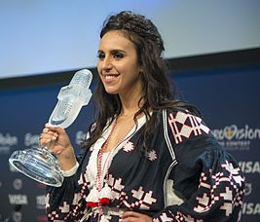

Slide 7
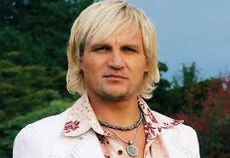

Slide 8
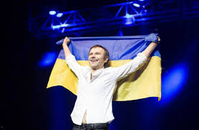

Slide 10
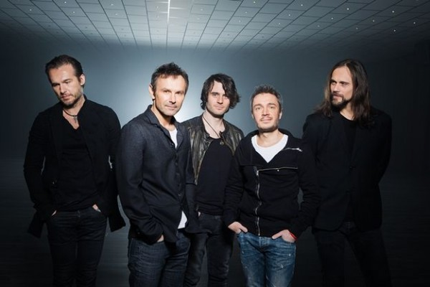
Okean Elzy: Iconic Ukrainian Music Band
Okean Elzy:
Iconic Ukrainian Music Band

Slide 11
If asked about the most popular music band in Ukraine, most people will answer «Okean Elzy».
The band was formed in Lviv in 1994. In 1998 their "Tam de nas nema" debut album comes out. It brings Okean Elzy instant success, which does not leave the musicians till today. Since that time they have released 10 albums,8 singles and made 2 solo projects.
Ocean Elzy concerts gather thousands of fans. The band was often invited to perform in Canada, Australia, US and other countries around the globe.

Slide 12
It has the highest popularity ratings not only in Ukraine which is quite phenomenal for a Ukrainian group, considering that all the lyrics are written in Ukrainian. Their solo concerts with live sound, musical drive, combination of Ukrainian poetry, of Slavic melodies and European sound conquer listeners irrespective of geography.

Slide 13
The group is active in political and public life fighting for peace and democracy. On December 14th, 2013 Okean Elzy performed live on the stage of Euromaidan. This concert gathered over a hundred thousand of fans on Maydan Nezalezhnosti and all the surrounding streets. It became a strong emotional charge for all the protesters and the most massive live music performance in the history of Ukraine.

Slide 14
Currently the band’s members are: Denis Glinin (drums), Denis Dudko (bass guitar), Milos Jelic (keyboards), Vladimir Opsenica (guitar). The band’s founder and ideologist Slavko Vakarchuk has been the front man of Okean Elzy for 23 years

Slide 15
He is the author of most
texts and music,takes part
in many cultural and social
projects.
. According to the weekly Reporter, Vakarchuk is included in the first hundred of the most famous people in Ukraine.

