Slide 1
WILLIAM SHAKESPEARE’s BIOGRAPHY
“TO BE OR NOT TO BE, THAT IS THE QUESTION“ WILLIAM SHAKESPEARE

Slide 2
WILLIAM SHAKESPEARE 1564-1616

Slide 3
Stratford-upon-Avon, England, 23d April, 1564

Slide 4
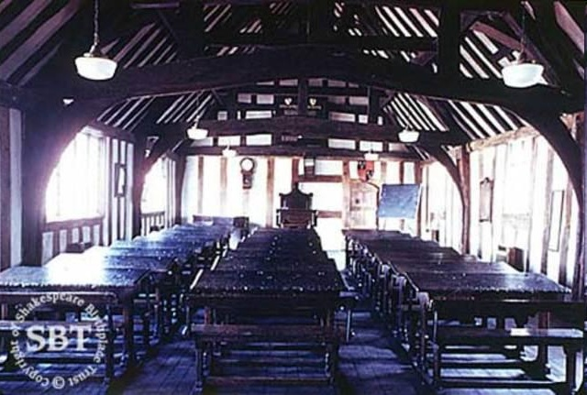
King Edward VI Grammar school in central Stratford

Slide 5
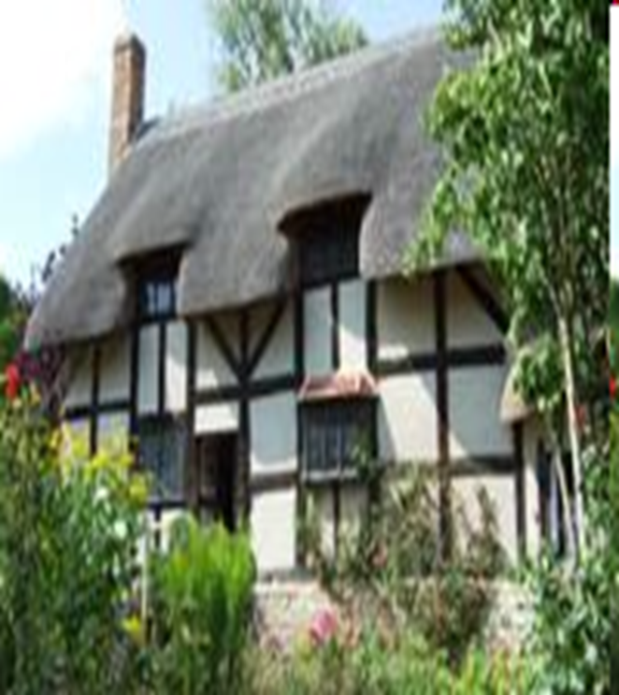
Anne Hathaway. Temple Grafton.

Slide 6
Work in London

Slide 7
Shakespeare – an actor

Slide 8
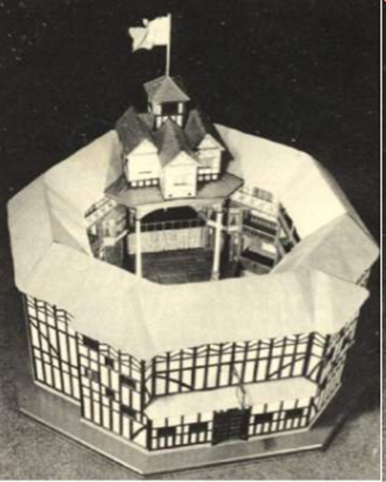
The Globe Theater

Slide 9
Shakespeare’s large house “New place”

Slide 10
Shakespeare's tomb in the church of Holy Trinity at Stratford-upon-Avon

Slide 11
Thank you very much for your attention
Zeleniuk Diana and
Zelinska Ivanna 11th form.

