Slide 1
SHAKERSPEAR
AUTHORSHIP

Slide 2
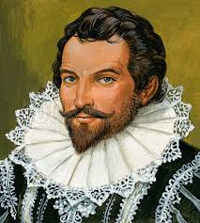
POSSIBLE CANDIDATES

